Slide 1
IT Platform Simplification Executive Summary
January 2024

Slide 2
Where we started
Identified Pain Points
What Makes XX so complex?
Proposed Solutions
APPENDIX

Slide 3
The Kin + Carta team
Kevin Gumz
VP, Agriculture Portfolio Delivery Partner
Trey Secord
Project Lead, Principal Strategist/UXD
Purna Annapureddy
Technical Principal, Architect
Danny Cohn
Technical Director, Practice Lead
Anna Dooley
User Experience Designer

Slide 4
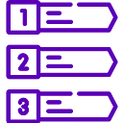
We completed 3 bodies of work in the past 2 months
Extensive Stakeholder Interviews
Conducted 31 interviews with XX team members and stakeholders to gather vital feedback to inform K+C’s simplified recommendations.
Architecture
Audit
We dove head first into XX’s system architecture to better understand where improvement is needed and what’s missing.
Actionable Recommendations
Based on the outcomes, we developed actionable recommendations to help improve XX’s overall vision of event-driven architecture and to modernize their current architecture.
Notes:
Quick slide on what we did, then move into why XX is so complex

Slide 5
We uncovered 4 key areas to reduce complexity…
Design System + UX Standards
Data Quality + Integration
Prioritization + Governance
Engineering Challenges
Disrupting day to day operations + Impacting UX
Producing rework + gaps in documentation and process
System complexities impacting UX + fragmented standardization
Producing rework + difficulties with scaling or innovating designs due to restraints
Notes:
Data Quality + Integration: XX faces critical data management challenges, including data quality issues, duplication, performance bottlenecks, and a lack of unified data systems, leading to disruptions in daily operations.
Prioritization + Governance: XX's internal teams face challenges with a "build-first, fix-later" culture, lacking formal prioritization and governance, leading to application complexity, inconsistencies, and inefficient resource allocation.
Engineering Challenges: XX faces internal engineering challenges, including slow API’s, legacy system complexities, insufficient documentation, and governance concerns, impacting its day to day operations.
Design System + UX Standards: XX currently lacks a comprehensive design system, which has led to issues like inconsistent user interfaces, increased development time and cost, brand dilution, and difficulties in scaling both new and old features, largely due to resourcing constraints.

Slide 6
What makes XX so complex?

Slide 7
Data Quality + Integration
41
References in Interviews
XX faces many data and integration complexities:
Governance
No governance on how to build or integrate consistent & preformant APIs
No governance structure on data quality and integration processes
API’s misconfigured causing performance issues (XX, Mulesoft, Salesforce, SAP)
Data inaccuracies disrupt daily operations (trusting the data down stream)
No data record system on where the data exists or who the owner might be
One contributing factor is the point-to-point integrations I mentioned earlier. These integrations have been implemented multiple times, but each team has developed them differently over time, leading to inconsistency.”
Strategy
Siloed dev teams are causing the API’s to be duplicated without others knowledge
Not measuring the right KPIs to benchmark performance properly
Too many redundant API’s built over a long period of time by many different teams
The duplication of APIs is causing poor performance across Mulesoft, SAP and Salesforce
Tools
Multiple reporting tools across teams causes inconsistencies with the data (Qlik, Amplitude, Tableau and Power BI)
Notes:
We have an Estimated Availability and Supply Report that takes around four to five hours to run. Therefore, we only run it once a day. Our planning is based on this report.
Strategy / Tools / Governance bucket for these categories
Too many redundant API’s built over a long period of time by many different teams
No governance around how to build consistent APIs
No governance structure on data quality
Siloed teams are causing the API’s to be duplicated without other teams knowing
API’s misconfigured causing performance issues
Not measuring the right KPIs to benchmark performance.Data duplication caused by multiple teams creating similar or the same API pulls from Mulesoft, SAP and Salesforce
The duplication of APIs is causing poor performance across Mulesoft, SAP and Salesforce
Multiple reporting tools across teams causes inconsistencies with the data been pulled in and out of Mulesoft,
No data record system
Daily batch updates
Inaccuracies disrupt daily operations

Slide 8
Prioritization + Governance
43
References in Interviews
Lack of proper prioritization and governance has fostered a “build-first, fix-later" culture within XX:
Strategy
The absence of consistency across teams in XX has lead to many variations in practices and processes, impacting collaboration and efficiency
The absence of clearly defined internal processes and governance within XX has lead to inefficiencies and potential risks due to uncertainty in task execution and decision-making
Inefficient resource allocation resulting from changing priorities or rework has lead to suboptimal resource utilization, increased costs, and reduced overall productivity for XX
The absence or misuse of a structured decision-making framework within some teams has impacted how priorities are set and managed within XX
Managing a complex issue becomes exponentially more challenging when dealing with multiple groups, opinions, and priorities. This complexity can negatively impact timeliness and overall quality of the outcome.”
Tools
Application complexity affects the growing intricacy and sophistication of XX’s applications, which poses development and maintenance challenges
Notes:
We have an Estimated Availability and Supply Report that takes around four to five hours to run. Therefore, we only run it once a day. Our planning is based on this report.

Slide 9
Engineering Opportunities
56
References in Interviews
K+C uncovered these engineering opportunities during our stakeholder interviews:
Governance
No governance when build new features causes rework
Lack of proper documentation on how to consume data correctly
Legacy system challenges (SAP, Salesforce) causing performance issues (too many API calls, too many duplications)
Duplicate or misconfigured APIs are causing performance bottlenecks in multiple applications (XX, Mulesoft, SAP, Salesforce)
Lack of proper development best practices
If somebody says give me these 30 end points and give me a Mulesoft end point for it, what we have done is we have created a monster within Mulesoft, but you would have created the same monster if you had used Informatica or if you had used you know, any other platform.”
Strategy
Define principles and policies consistent with the reference architecture
Resource constraints (not enough people to complete work efficiently)
Lack of cross team collaboration causes unnecessary work that might already be completed or planned
Shifting priorities cause large amount of tech debt which rarely gets revisited
Knowledge gaps from team to team causes increases inefficiencies (not enough collaboration/sharing of cross platform knowledge)
Notes:
We have an Estimated Availability and Supply Report that takes around four to five hours to run. Therefore, we only run it once a day. Our planning is based on this report.

Slide 10
Design System + UX Standards
16
References in Interviews
The absence of a design system within XX's organization has resulted in UI design inconsistencies, delayed feature releases, increased technical debt, and a dependence on manual review processes.
Governance
Incomplete asset library (XX has the component library foundation for NA)
Inconsistent user interfaces (web to mobile)
Inconsistent user experience (multiple login pages, pages are slow)
No complete design system Increases development time and cost to build designs from incomplete assets (need a full asset library across brands)
Design complexity arises from the need to specify component usage for different product categories. Clear guidelines are essential to determine where and why each component should be used, particularly custom components.”
Strategy
Difficulty scaling new and old features without a large amount of effort from multiple team members (who are already stretched on time)
Resourcing constraints is one of the main drivers to not having a complete design system (no one has the time)
Hard to test new or updated features with customers (teams don’t want to share customer details)
Notes:
We have an Estimated Availability and Supply Report that takes around four to five hours to run. Therefore, we only run it once a day. Our planning is based on this report.

Slide 11
Solutions to simplify these complexities + address critical areas
Persona- Based Data Domains
Event-Driven Architecture
Design System
Change Enablement
FOUNDATIONAL
Given the potential amount of organizational change, Change Enablement is going to be a key driver in our recommendations. We see it as vital for success in XX’s simplification initiative.
Notes:
Data Domain / Persona (growers & sellers) and purpose (processing orders, etc.)

Slide 12
How we’ll measure success
Metrics and KPIs chosen with purpose and supports product success. With each solution we have recommended specific metrics to ensure are being tracked to measure progress on reducing such complexities
Measuring Product Success
Metrics related to sales, customer satisfaction, market share, and other indicators that gauge how well the product is performing in the market.
Strategic Product Development
Align product development activities with overall business strategies. By defining clear metrics, organizations can ensure that product features and enhancements contribute to the achievement of broader business objectives.
Customer Satisfaction and Feedback
Understanding how users interact with the product allows for continuous refinement, enhancing the user experience and increasing customer loyalty.
Resource Optimization
Organizations can focus their efforts on product features and enhancements that have the most significant impact on success, optimizing development resources and maximizing return on investment.

Slide 13
Solution 1:
Event-Driven Architecture
Solving for these areas of improvement:
Data Quality + Integration
Prioritization + Governance
Engineering Challenges

Slide 14
Industry Definition of Event-Driven Architecture
Scalability
Real-time Processing
Distributing events among multiple consumers, optimizing resource usage
Immediate responses to system changes
Event-Driven Architecture is a software design approach that focuses on reacting to events, like notifications in a system. These events can happen at any time and are often triggered by things like user actions, or data from the outside world. EDA is all about being responsive to what's happening without waiting for specific requests.
Loose Coupling
Integration
Enable independent evolution for maintainable, modular code
Ease third-party integration, fostering seamless data exchange and interoperability
Fault Tolerance
Resilient to failures since events can be retried or handled by backup components, ensuring system availability.
XX Fulfilled
Incomplete Fulfillment
Notes:
Puzzle pieces
Using technology that is not enterprise approved by XX

Slide 15
What complexities does EDA simplify?
Data Quality + Integration
Prioritization + Governance
Engineering Challenges
Data Consistency: By enforcing data updates through events, EDA can maintain data consistency across multiple systems or databases. Events ensure that changes are applied uniformly and consistently to all relevant parts of the system.
Data Transformation: EDA can include components that transform and enrich data as it flows through the system. This is particularly useful for integrating data from disparate sources with different formats, ensuring that data is standardized and consistent.
Data Versioning: In some EDA implementations, events can include data versioning information, helping to track and manage changes to data over time.
Audit Trails: Events in EDA systems can serve as audit trails, capturing a history of data changes and interactions. This is valuable for compliance, tracking changes, and troubleshooting data quality issues.
Flexibility and Extensibility: EDA systems are often more flexible and extensible. Developers can add new features or components by subscribing to relevant events, reducing the need for extensive code changes.
Ease of Integration: EDA simplifies the integration of new components or services into an existing system. This can make it more attractive for developers and teams to adopt EDA when they know that integrating their new functionality will be straightforward and not disrupt existing processes.

Slide 16
Impact of Event-Driven Architecture
Event-driven architecture has the potential to bring significant and transformative changes within XX by:
Reduced Downtime
Fault tolerance and error handling capabilities can reduce system downtime and service interruptions. This leads to improved reliability and customer satisfaction, as well as potential cost savings from avoided outages.
Faster Time to Market
Enables faster development cycles and shorter time-to-market for new products and features. This agility can help you seize opportunities and respond to market changes more effectively.
Improve Cost Efficiency
Scalability and resource optimization can result in cost savings by ensuring that you allocate resources efficiently and avoid overprovisioning.
Improve Customer Retention
Enhanced customer experiences, real-time responsiveness, and personalized interactions can lead to higher customer retention rates and increased customer satisfaction.
Culture of Continuous Improvement
Helps foster a culture of continuous improvement and learning within XX as teams embrace proper agile and iterative development practices.

Slide 17
Best practices that establish habits + formalize process
Teams Collaboration Collaborate through Arch/Tech Sync, reviewing technical and product specifications for alignment, including contracts, integration points, KPIs, resulting in defined user stories; and Product Sync, where TLs, archs/EMs, and UX review the product spec, leading to the identification of epics and features.
Event-Driven Architecture
Guidelines for naming conventions, security, etc., utilizing correlation-ids for failure tracking, and implementing a Dead Letter Queue (DLQ) process.
Monitoring
Establish P50, P90, and P95 dashboards for API monitoring to detect outliers or failures and implement an alerting system for teams to address issues promptly.
UX/UI Design
Develop a design system, utilize storyboards with common components, and implement variable styles to apply diverse aesthetics across various brand sites and applications.
BFF (Backend For Frontend):
The process involves calling relevant microservices, formatting data for the frontend, and sending it, with each application team owning and deciding the technology for their specific Backend For Frontend (BFF) focused on a single UI.
Mulesoft Domain Services, owned by Mulesoft/Integration team, handle domain-specific logic and data mapping between sources, while System Services, responsible for basic CRUD operations, access end systems like SAP and Salesforce.
Notes:
https://superfriendlydesign.systems/articles/design-systems-pilots-scorecards/

Slide 18
Recommended Approach
The recommended approach to incorporating Event-Driven Architecture:
1.
Identify Business Use Cases
Begin by identifying the precise business scenarios where Event-Driven Architecture can bring significant benefits. Look for situations where immediate data processing, quick responses to events, and loosely connected systems can make a substantial impact. We recommend starting with Mulesoft which has been identified as requiring the most attention.
TRACKING SUCCESS | SUGGESTED KPIS
Error Rates are a measure of how effectively data updates are being performed, indicating the level of synchronization between subscribing systems
Event Processing Times reflect the speed at which systems receive updates
Throughput measures the frequency of updates, indicating how often data requiring updates is sent
2.
Implement Event Processing
Develop event processing logic that handles incoming events. This can involve data transformation, validation, enrichment, and orchestration of actions based on the received events.
3.
Define Event Sources
Determine the sources of events within your systems.
4.
Ensure Scalability
Design your Event-Driven Architecture system to be scalable, allowing it to handle a growing volume of events and consumers.
5.
Monitor and Logging
Integrate monitoring and logging solutions to trace event flow, identify problems, and collect performance data.
6.
Testing
Thoroughly test your EDA system under various scenarios, including high event loads, to ensure its reliability and responsiveness.
7.
Deployment and DevOps
Establish deployment pipelines and DevOps practices for continuous integration and continuous deployment (CI/CD) of your components.

Slide 19
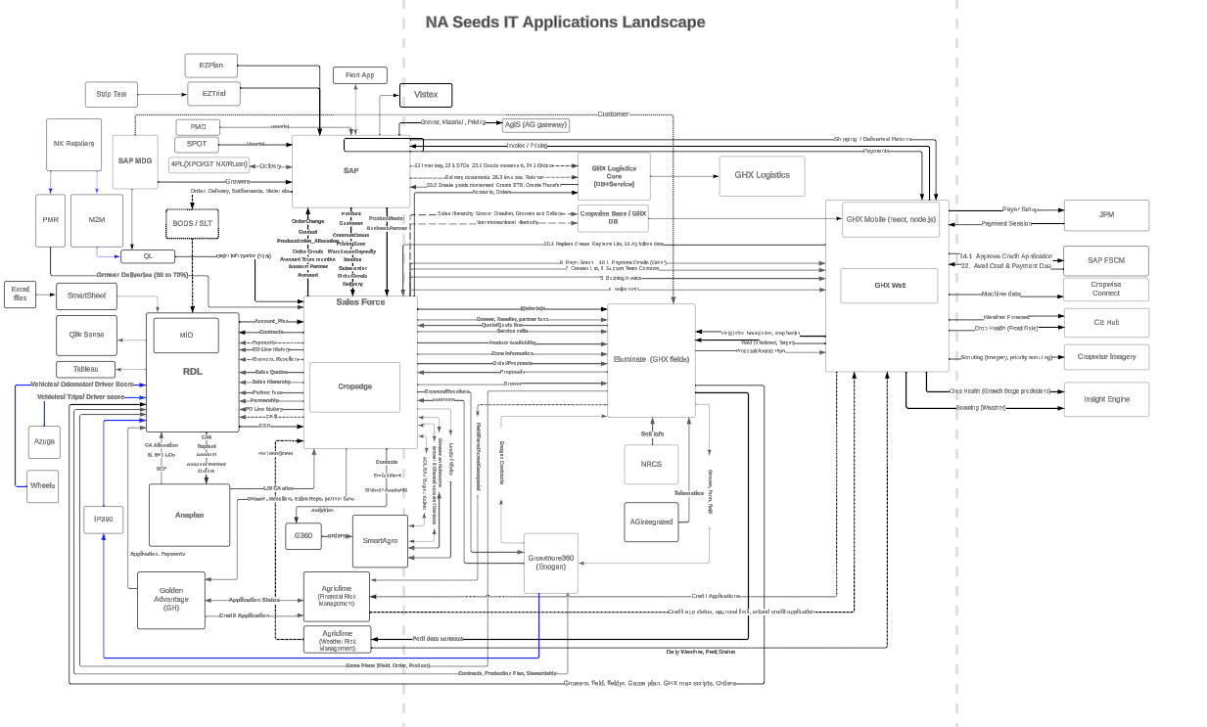
Architecture (Old)

Slide 20
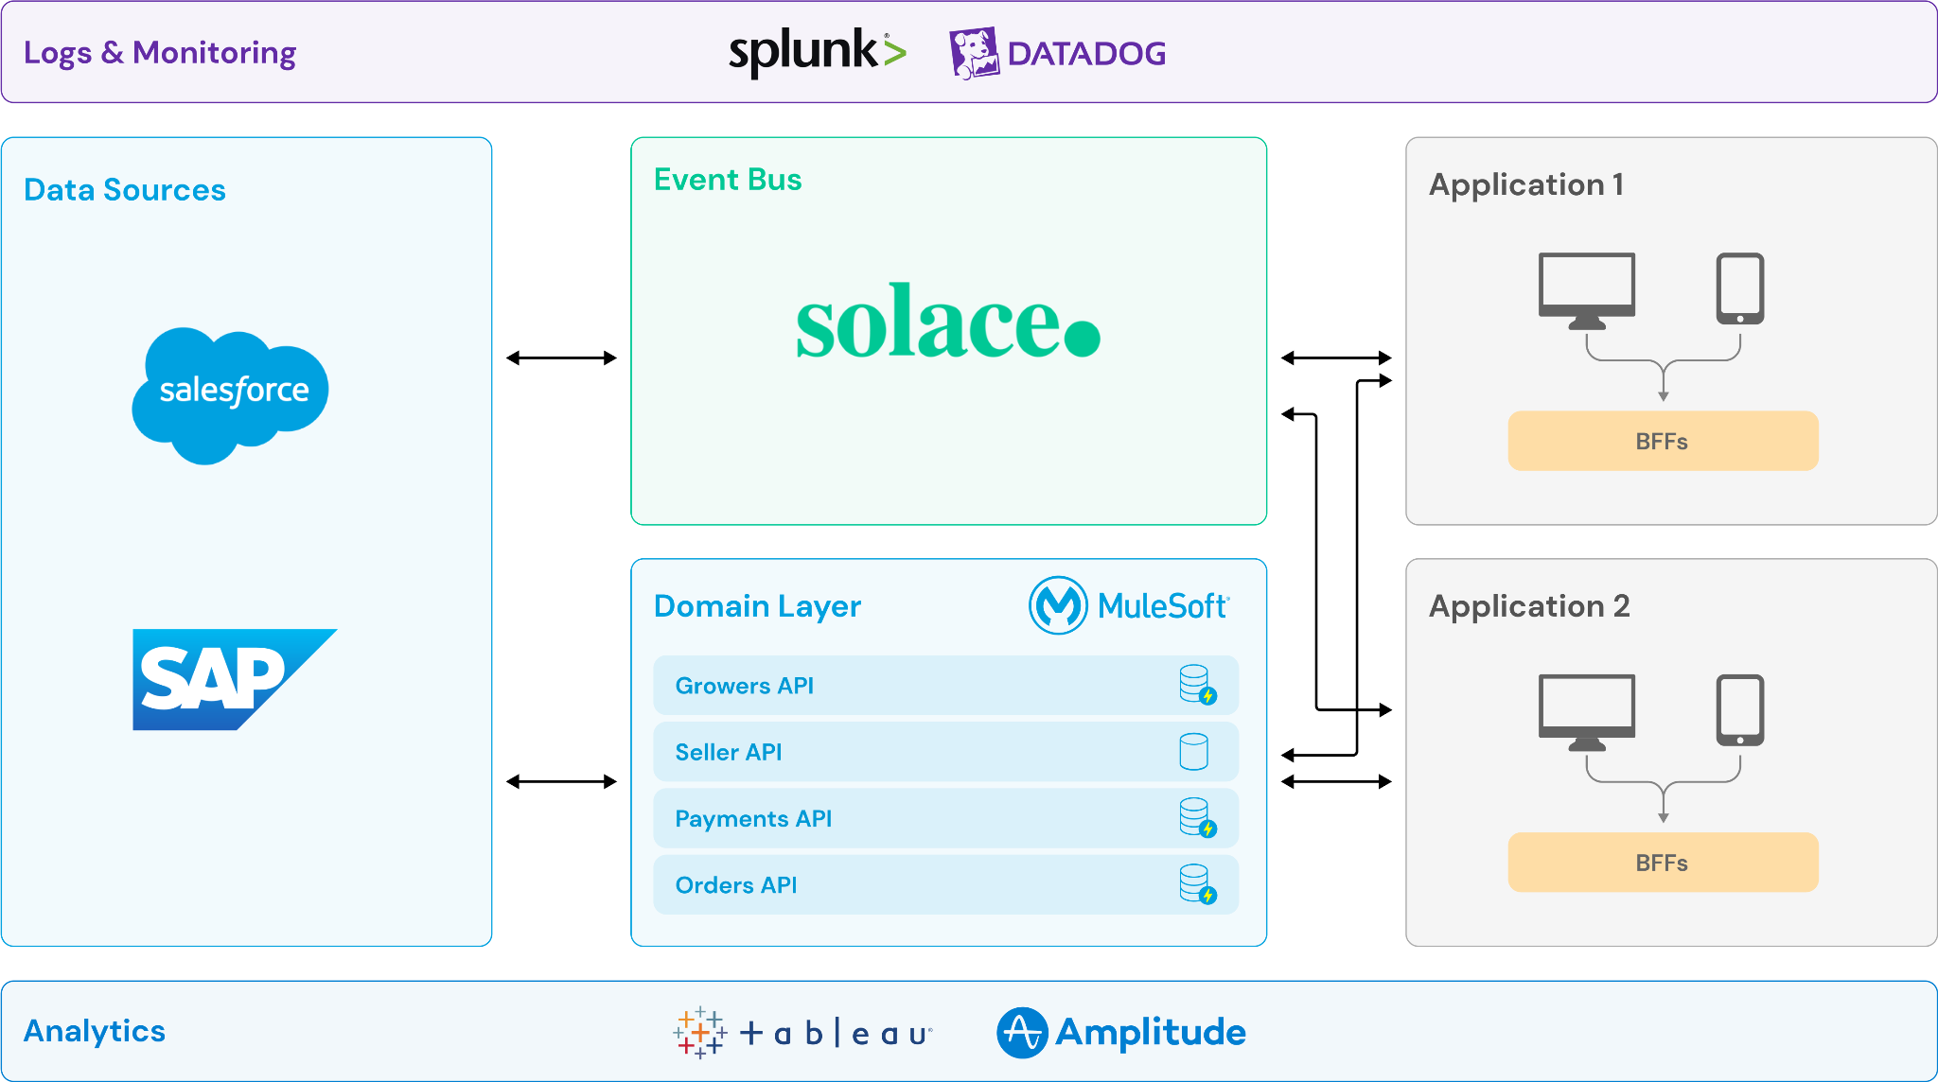
A look at the framework
Notes:
Purna to walk through the reference architecture piece

Slide 21
How will EDA benefit XX?
Easier Scalability
Improved Data Integration
Event-Driven Architecture enables immediate responses to events, allowing businesses to react swiftly to changing conditions and customer interactions. This real-time responsiveness can enhance customer satisfaction and competitiveness.
Allowing businesses to handle increased workloads and data volumes without significant architectural changes.
Simplifies integration across systems by providing a standardized way to exchange information through events. This reduces the complexity of integrating disparate systems and data sources.
Enhanced Customer Experience
Enhanced Analytics + Insights
Allowing businesses to handle increased workloads and data volumes without significant architectural changes.
Wealth of event data that can be leveraged for analytics and gaining insights into customer behavior, operational efficiency, and market trends

Slide 22
Solution 2:
Persona-Based Data Domains
Solving for these areas of improvement:
Prioritization + Governance
Engineering Challenges

Slide 23
Industry Definition of a Data Domain Approach
Data Ownership
Data Organization
Accountability for data management is established
Data is well-structured for easy management and access
Data Consistency
Data Quality
A Data Domain Approach is like sorting and organizing data into different groups based on what it's used for or who's in charge of it. Each group has its own rules and management, making data easier to handle and use. It helps keep data clean, safe, and organized.
Data adheres to standards within domains, reducing discrepancies
Data adheres to quality standards, reducing errors and inconsistencies
Enhanced Collaboration
Cross-functional teams work together more efficiently and productively
XX Fulfilled
Incomplete Fulfillment
Notes:
Better Data Organization
Enhanced Data Quality
Clear Data Ownership
Efficient Data Integration
Data Consistency
Enhanced Collaboration
Simplify Data Migration

Slide 24
What complexities does this solve for?
Prioritization + Governance
Engineering Challenges
Clear Data Ownership: Assigning data ownership to specific domains clarifies accountability for data management and stewardship, ensuring that there are responsible individuals or teams for each set of data.
Enhanced Data Quality: By defining specific data quality standards and governance policies for each domain, organizations can improve data quality and consistency within those domains, leading to more reliable and trustworthy data.
Team Collaboration: Cross-functional collaboration is enhanced when data is organized by domains, as developers can work more effectively with data professionals and other teams involved in data-related projects.
Data Consistency: Working with data that adheres to consistent standards within domains reduces the complexity of data handling and processing in application development.

Slide 25
Impact of Persona-Based Data Domains
Persona-Based Data Domains can reduce data errors and clean up API calls for XX by:
Simplify Data Migration
Data transfer during migrations is simple and straightforward.
Enhanced Data Quality
Data adheres to better quality standards, reducing errors and inconsistencies.
Clear Data Ownership
Accountability for data management is more easily established
Data Consistency
Data adheres to standards within their respective domains, reducing discrepancies.
Efficient Data Integration
Data from diverse sources integrates seamlessly.
More
Collaboration
Cross-functional teams collaborate more effectively with a data domain approach.
Better Data Organization
When setup correctly data is well-structured for easy management and access

Slide 26
Recommended Approach
When implementing persona-based data domains XX should consider these recommendations as part of a holistic approach across teams and applications:
TRACKING SUCCESS | SUGGESTED KPIS
Error Rates/Failure rates provide insights into data issues within the system
Response times indicate the speed at which systems consume data or updates
Resource utilization assesses how efficiently systems consume resources, including their consumption rate
Number of recurring issues measures both the frequency of problems and the overall data quality, particularly in platforms like ServiceNow or Zendesk
1.
Identify, design and build data domains
(Grower, seller, orders, etc)
2.
Define + Map Data Attributes
to be consumed by the domains (address, phone, customer details, etc.)
3.
Data Ownership
Work with stakeholders to establish data ownership
4.
Governance Process
Incorporate governance processes to help teams adhere to development best practices
Notes:
Some teams have some of these features, while others have none.
Migrating existing API’s makes this complicated 3 to 4 month plan to implement

Slide 27
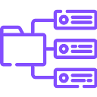
How will this benefit XX?
A data domain approach within XX means organized and dependable data, clear ownership, easy mixing of data, security, automation, and quick access. It aids rule compliance, smarter decisions, data consistency, and seamless data transfers. It encourages teamwork and will save your organization money.
Streamlined Data Organization
Data Quality &
Governance
Simplified Data
Discovery
With a data domain approach, data is organized into specific categories or domains based on its purpose or usage. This structured organization makes it easier to locate, access, and manage data efficiently.
Each data domain can have its own set of data quality standards and governance rules. This leads to improved data accuracy, consistency, and reliability, reducing errors and data-related issues.
Data discovery becomes quicker and more straightforward because data is well-organized within domains. Users can easily locate and access the data they need, saving time, effort and money.

Slide 28
Solution 3:
Implement a Design System
Solving for these areas of improvement:
Prioritization + Governance
Design System + UX Standards

Slide 29
Industry Definition of a Design System
Style Guide
Component Library
Defined design principles, color palette, typography, and visual elements to maintain consistency
Reusable UI components for consistent interface creation
Documentation
Code Guidelines
Comprehensive guidelines for both design and development aspects of the system
Offer developers clear instructions on implementing design system components in code
A comprehensive and cohesive set of guidelines, principles, assets, and tools that are systematically organized to facilitate the creation, maintenance, and consistent implementation of a user interface across digital products.
It serves as a central reference point for design and development teams, providing a shared language and framework to ensure visual and functional consistency throughout an application or a suite of products
**XX has established some of the elements included in a design system in hopes to reduce rework and have shareable components
Accessibility Consideration
Design Principles
Integrate guidelines to ensure the design is accessible to people with disabilities
Establish clear and well-defined principles guiding design decision-making
Version Control
Research + Feedback
System for versioning to track changes and updates effectively
Continuous feedback loops with users to improve the design system over time
XX Fulfilled
Incomplete Fulfillment
Notes:
Tag Morgan

Slide 30
What complexities does this solve for?
Prioritization + Governance
Design System + UX Standards
Tech + Design Alignment: Design felt at times they were being pushed to deliver features without having time to align with tech on details and specs. Design Systems establishes alignment between teams by easily being able to see who owns what.
Reduce redundant work: The focus of a design system is alignment to a set of core principles, styles, and patterns. It provides reusable design AND developed components that can easily be plugged into new features or products.
Feature Prioritization: Innovative and new features currently lack the ability to be prioritized due to bugs and fixes typically being top priority. Established design systems leave more time for innovation and collaboration on products.
Reduction of Design Debt: By addressing design complexities upfront, design debt (accumulated design-related issues) is minimized, resulting in more maintainable and adaptable systems.

Slide 31
Impact of a Design System
A Design System is a way for disparate teams within an organisation (or agency partners) to design and develop digital experiences in alignment to a set of core principles, styles, and patterns—in other words, using a common design language.
In some ways, the terminology of “Design Systems” is misleading. It affects so much more than JUST design.
Strategic Benefits
Strong digital foundations enable organizations to adapt and scale efficiently. Consistency across platforms facilitates quick changes and enhances the ease of testing and learning.
Operational Efficiencies
Having teams aligned around a set of common principles and building blocks, means outputs are delivered consistently and effort is not duplicated - driving down overheads and wastage.
Increased Revenues
Creating a Design System with baked in accessibility can enable you to create more inclusive products. Unlocking a potential user-base increase of 20%, when designing for users with specific accessibility requirements.

Slide 32
Even for development…
Reduced technical debt
Less jumbled legacy frontend code.
Faster production
Less time coding common UI components and more time building real features and products.
Higher-quality production
Bake in and enforce frontend best practices; teams can focus on iterating and improving rather than reinvention.
Reduce QA effort
Centralise certain QA tasks
Potentially adopt new technologies faster
A Design System can help make adding additional frameworks/technology more manageable.
Useful reference
An essential resource and hub for development best practices, through documentation and code repository.
Future-friendly foundation
Modify, extend and improve upon over time.

Slide 33
Recommended Approach
1.
Component Inventory
Begin by conducting an inventory of existing design components used across projects.
Identify common elements that can be standardized, such as buttons, forms, typography, and color schemes.
TRACKING SUCCESS | SUGGESTED KPIS
2.
Define Design Principles
Establish clear design principles that reflect XX’s identity and user experience goals.
Define the visual language that will guide the creation of new components and the standardization of existing ones.
Usability Testing Success Rate: Percentage of successful tasks completed in usability testing.
Visual Appeal Ratings: Ratings on the attractiveness and visual appeal of the design.
Consistency Across Design Elements: Evaluation of design elements for uniformity and coherence.
Time Spent on Design Iterations: Time invested in refining and iterating design elements.
Conversion Rate by Design Variant: Effectiveness of different design variations in driving user actions.
Click-Through Rate (CTR): Percentage of users clicking on specific design elements.
Task Success Rate in User Testing: Percentage of successful task completion in user testing.
Accessibility Compliance Score: Evaluation of the design's adherence to accessibility standards.
3.
Incremental Expansion
Establish clear design principles that reflect XX’s identity and user experience goals.
Define the visual language that will guide the creation of new components and the standardization of existing ones.
4.
Training and Collaboration
Conduct training sessions, foster cross-functional collaboration between design and development teams.
5.
Governance and Documentation
Establish governance for updates, version control, and conflict resolution. Develop and maintain comprehensive documentation
6.
Iterative Feedback and Adoption
Gather iterative feedback, optimize the design system, and actively promote its adoption across projects.
Additional Metrics that inform for design and beyond on next slide…
Notes:
XX has the foundation to start with / Outsystems & Outsystem dev’s is missing the foundation XX could provide and the experience.
We also need to mention the benefits of storybook - https://storybook.js.org/

Slide 34
PERFORMANCE
NPS Scoring
Identifying Metrics
Measure how much customers like a company. It helps businesses know if customers are happy and loyal. It's used in different industries like marketing and customer service.
Promoters (score of 9 or 10)
Passives (score of 7 or 8)
Detractors (score of 0 to 6)
NPS Trend Over Time
NPS by Customer Segment
NPS by Product Category
NPS by Geographic Region
NPS Impact on Customer Retention
Follow-up Actions Based on NPS Feedback
Net Promoter Score
Customer Satisfaction Score
CSAT Scoring
SUS Scoring
Measure and understand customer satisfaction, identify areas for improvement, and gauge the effectiveness of their customer support efforts.
Questionnaire tool for evaluating the ease of use of software, websites, or devices. Standard now in UX research and product development to assess usability and learnability.
The System Usability Scale
Order Accuracy Rate
Shipping Timeliness
Product Quality Ratings
Customer Support Resolution Time
Return Rate
Website Conversion Rate
Customer Feedback Ratings
Inventory Turnover
Average Order Value (AOV)
Uptime Percentage
Mean Time Between Failures (MTBF)
Mean Time to Recovery (MTTR)
Number of System Downtime Incidents
Incident Resolution Time
Error Rate
Response Time for Online Transactions
Performance Metrics (e.g., server response time, page load time)
Customer Impact Metrics During System Failures
Notes:
To calculate the RICE score for an idea or feature, you can use the following formula: RICE Score = (Reach x Impact x Confidence) / Effort
MoSCoW - There are no numerical scores involved in MoSCoW; instead, it relies on qualitative categorization (Can be done in MIRO)

Slide 35
How will this benefit XX?
Design systems are crucial for a company that is looking to expand their portfolio of products, but maintain customer satisfaction and encourage adoption. It creates structure in the chaos and opens up day to day hours that could be utilized on innovation and efficient launches.
Speed to Market
Innovation
Reduce Rework
use of reusable components and shared guidelines minimizes repetitive tasks. This efficiency is crucial for swift adaptation to changes. The impact on workflows, such as parallel development + rapid onboarding, enables quicker overall product delivery, meeting market demands more effectively.
accelerates innovation by streamlining processes, freeing creative energy for experimentation, and fostering collaborative problem-solving. Standardization ensures consistency, while efficient collaboration across teams encourages creative exploration and idea generation.
eliminates the redundant work between design and development in turn saving hours of work. Plug and play elements are much quicker to implement requiring less from dev. It also enables bugs or fixes to be optimized and successfully solved quicker and more permanently.

Slide 36
Solution 4:
Administer Change Management
Solving for these areas of improvement:
Data Quality + Integration
Prioritization + Governance
Engineering Challenges
Design System + UX Standards

Slide 37
Industry Definition of Change Management
Clear Communication
Leadership Support
Transparent and consistent communication about the change, addressing the why, what, and how to all stakeholders
Visible and active support from organizational leaders to inspire confidence and commitment among employees
Stakeholder Involvement
Comprehensive Plan
Involve key stakeholders in the change process, seeking their input and addressing concerns to build a sense of ownership
Well-defined and detailed change management plan that outlines objectives, timelines, and specific actions required for success
Change management is a structured approach focused on smoothly transitioning organizations from their current state to a desired future state.
It involves systematic planning, communication, and addressing human and organizational aspects to minimize resistance and ensure successful adaptation to changes, such as new processes or technologies. The goal is to create a positive environment, minimize disruptions, and achieve desired outcomes.
Training + Development
Feedback Mechanisms
Integrate guidelines to ensure the design is accessible to people with disabilities
Establish clear and well-defined principles guiding design decision-making
Cultural Alignment
Monitoring + Eval
System for versioning to track changes and updates effectively
Continuous feedback loops with users to improve the design system over time
XX Fulfilled
Incomplete Fulfillment

Slide 38
What complexities does this solve for?
Data Quality + Integration
Prioritization + Governance
Engineering Challenges
Design System + UX Standards
Consistent & preformant APIs: Ensures the consistent and performant nature of APIs through standardized & development best practices, version control, testing, monitoring, documentation, and user feedback.
Siloed dev teams: Encouraging collaboration, transparency, and standardized processes among siloed development teams, enabling them to work cohesively towards common goals.
Governance: Strengthens governance by ensuring that changes align with policies, are well-documented, transparent, and compliant, while also providing a structured framework for decision-making and risk mitigation.
Prioritization + Execution:
drives effective prioritization and execution by providing a structured framework for evaluating, selecting, planning, and implementing changes in alignment with XX goals.
Streamlined Processes:
Aids in offering a structured approach that supports the implementation of changes, mitigates risks, and facilitates smooth transitions in engineering processes and applications.
Data Standards:
Promotes the establishment and adherence to data standards by providing a structured process that ensures clear communication, documentation, and training for all stakeholders.
Adoption:
Supports the adoption of a design system by ensuring clear communication, user education, feedback integration, training, and alignment with XX’s business goals, ultimately promoting its effective utilization and minimizing resistance to change.

Slide 39
Impact of utilizing Change Management
The impact of using change management in major IT and design process changes is a smoother transition, reduced resistance, and consistent adoption, ultimately fostering a more efficient and positive organizational shift.
Reduced Resistance
Employees may initially resist changes in IT systems. Change management helps address concerns, communicates the benefits of simplification, and guides users through the transition, minimizing resistance.
Faster Adoption of New Technologies
Accelerates the adoption of simplified IT systems and design principles by providing training, resources, and support, enabling a quicker and more seamless transition.
Increased Productivity
Minimizing resistance through clear communication, engaging employees in the process, and providing targeted training. It reduces uncertainty, maintains morale, and ensures efficient implementation of changes, fostering a focused and productive workforce.
Optimized Work Processes
Change management helps employees adapt to streamline IT processes and design standards, leading to increased efficiency, reduced errors, and improved overall workflow
Alignment with Strategic Goals
Change management ensures that IT simplification and design system initiatives align with the organization's broader strategic goals, maximizing the impact of these initiatives on overall business objectives.
Enhanced Collaboration
Through effective change management, teams involved in IT simplification and design system initiatives can collaborate more efficiently, fostering a shared understanding and commitment to the changes.

Slide 40
These three things drive transformation:
People
Process
Technology
Strengthening a culture of continuous learning and lean thinking through the development of high-performing, cross-functional product teams
Aggressively removing “decision latency” and activating a scalable, human-centered enablement framework to accelerate learning and skill acquisition
Establishing modern engineering concepts, practices, and tools to pursue operational excellence
Notes:
When we sat down to talk about enabling Modernization it boiled down to 3 things: People, Process, and Technology.

Slide 41
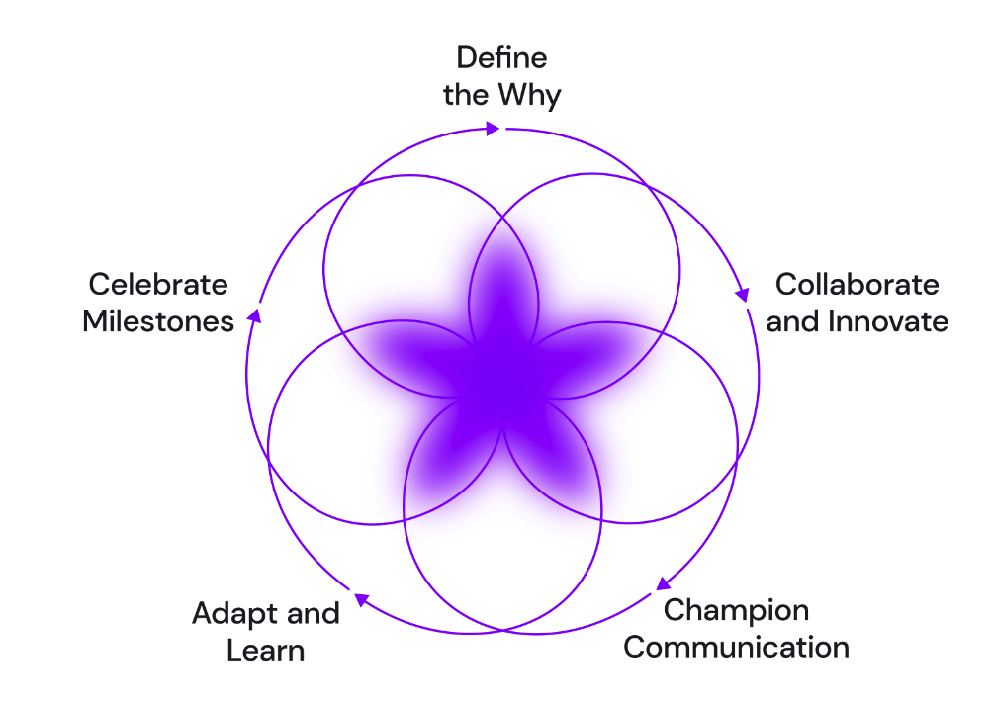
Key activity cycles ensure that changes that are being made become fully adopted

Slide 42
Recommended Approach
Change management will be the driving force behind the recommended substantial transformations both technical and design.
TRACKING SUCCESS | SUGGESTED KPIS
1.
Establish a Project Team
Build a designated change management team - this will ensure that it becomes a priority and not a side initiative that may fail due to the chaos of day to day responsibilities
Employee Engagement Score: Use employee surveys or engagement platforms to gather feedback on morale, motivation, and commitment.
Adoption Rate: Track the percentage of employees actively using and implementing the changes in their daily work processes.
Resistance Levels: Monitor resistance through feedback mechanisms, surveys, and direct communication to identify areas where resistance is high.
Communication Effectiveness: Evaluate the clarity and impact of communication by analyzing feedback, survey responses, and assessing the understanding of the change objectives.
Training Effectiveness: Measure the effectiveness of training programs by assessing the proficiency and application of new skills acquired by employees
Project Timeline Adherence: Measure how closely the actual milestones and tasks align with the planned timeline for the change initiative.
2.
Identify Core Objectives
Examine the IT simplification initiatives and identify the core objectives that need to drive success
Collaboration between teams
Transparency of roles and responsibilities
Establish a consistent working process (Agile)
3.
Manage Milestones
Change enablement team should establish milestones to indicate progress and manage them throughout the project, as well as after to ensure the changes implemented sticks

Slide 43
How will this benefit XX?
Change management is a strategic approach that addresses various complexities related to organizational changes, helping organizations navigate transitions successfully while minimizing disruptions and maximizing the benefits of change.
Ensures execution of simplification efforts
Implementing all of these technical and design changes are a massive lift. Change management is how you will keep these moving forward and ensure this is a adopted update. It’s like having a project management team for your internal transformations, it keeps track of how each element is running and the impact of its success.
Helps changes in process and structure stick
When companies are used to doing things a certain way, change becomes more difficult to implement for the long run, change enablement solves for that blocker.

Slide 44
Looking towards
implementation…

Slide 45
Learning through Doing
Retention is About Practice, Change is About the Individual
AUDITORY
5%
Lecture
PASSIVE
VISUAL
10%
Reading
20%
Audio-visual
30%
Demonstration
Allowing teams to practice what they learn in a safe learning environment is the key to achieving 75% retention.
Getting people to understand and buy-in to the WHY of the change, and HOW the change actually helps them achieve their goals (not just broader business goals) is critical to transformation.
KINESTHETIC
50%
Discussion
75%
Practice Doing
90%
Teach Others
ACTIVE
Notes:
https://docs.google.com/presentation/d/1BrgGBUdI24dMmPTPPhSZdjTdl-BqKP4jbiiLWs_6thw/edit#slide=id.g918344a6a2_5_11

Slide 46
Quick wins vs. Long haul
Recommendations
Design System
Design System
Change Enablement
+
+
Event-Driven Architecture
Event-Driven Architecture
+
Persona- Based Data Domains
Event-Driven Architecture
Persona- Based Data Domains
Event-Driven Architecture
Persona- Based Data Domains
Opportunity Areas
Approaching these recommendations aren’t as simple as quick wins vs long initiatives. What is key to understand with these transformations is that implementing one or a combination of them may only partially solve the problems
To see the opportunity areas 100% solved for it requires all 4 recommendations working together
Data Quality + Integration
40
60
70
100
Prioritization + Governance
20
40
50
100
Engineering Challenges
50
60
70
100
Design System + UX Standards
0
0
40
100

Slide 47
RICE Model
PERFORMANCE
Prioritization
Used in management, it assesses and ranks ideas based on impact, reach, confidence, and effort, aiding in prioritization with assigned scores.
Reach: How many people or users an idea or feature is expected to impact
Impact: Positive effect or outcome of the idea or feature on the user or business
Confidence: Confidence in the estimated impact and reach scores.
Effort: Amount of time, resources, and work required to implement the idea or feature.
The RICE framework assesses tasks based on reach, impact, confidence, and effort, while the MoSCoW framework categorizes tasks into must-haves, should-haves, could-haves, and won't-haves, enabling structured prioritization by considering factors like value, feasibility, and criticality.
OR
MoSCoW Model
Categorizing project requirements into Must-Have, Should-Have, Could-Have, and Won't-Have provides several benefits for efficient project management and decision-making.
Clear Prioritization: Intuitive method for prioritizing requirements based on their significance and impact on success.
Focus on Critical Deliverables: Must-Have criterias are essential and represent the core objectives.
Risk Mitigation: Identifying essential requirements early helps teams tackle risks and uncertainties promptly.
Alignment with Business Goals: Encourages stakeholders to align project needs with overarching business goals.
Notes:
To calculate the RICE score for an idea or feature, you can use the following formula: RICE Score = (Reach x Impact x Confidence) / Effort
MoSCoW - There are no numerical scores involved in MoSCoW; instead, it relies on qualitative categorization (Can be done in MIRO)

Slide 48
Benefits that go beyond the obvious
We have laid out the positive impacts this will have on various areas of XX’s business, but it’s important to know that these waterfall into much larger outcomes
Adoption + Revenue Growth
Speed to Market
Trust
The impact that a streamlined team process and improved user experience has on users willingness to adopt new products is monumental, and with that adoption comes net new revenue opportunities with better products.
Streamlining processes and ensuring that you are truly changing the way tech and dev operate increases space for items that will increase the ability to get features done quicker in turn, your speed to market.
Not only will this impact the trust users have in your products, but also internally it will support teams to be more confident in their day to day operations.
Ease of Use + Reduced Load Times
Innovation
Data Reliability
Improved Productivity
Bugs + Interaction
Currently: Only fix for that instance that was requested, not for all of the scenarios
Seamless UX
Design Quality
Manual Process Reduction

Slide 49
Links to Project Artifacts
Top 4 Drivers of System Complexity | Stakeholder Interview Summary Stakeholder Interview Final Readout
Reference Architecture
Development Best Practices
External XX Stakeholder Interview Insights

Slide 50
Thank You

