Slide 1
CX Strategy
Lead Management
Blueprint Readout
April 2024

Slide 2
Executive Summary
Understanding the Current State
Mapping the Service Blueprint
Crafting a Future State
Complete Ecosystem for Success
Next Steps
Appendix

Slide 3
Executive Summary
Executive Summary | Understanding the Current State | Mapping the Service Blueprint | Crafting a Future State | Complete Ecosystem for Success | Next Steps | Appendix
Click the white circles above to navigate to the desired section
Notes:
Madison

Slide 4
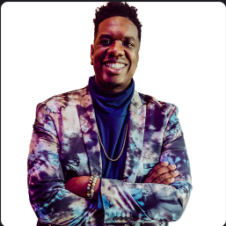
The Kin + Carta team
Morgan Sweet
Delivery Lead
Anna Dooley
Strategist
Franklin Ward
UX Designer
Santiago Diaz Bueno
Product Consultant
Kevin Gumz
Client Lead / Ag Portfolio Delivery Partner

Slide 5
The CX Team’s Mission
In order to understand how to increase the lead to conversion rate of our farmers, this team…
Utilized insights from sellers, farmers and stakeholders to define a service blueprint
Uncovered problem areas to align our technological and process-oriented strategies
Prioritized opportunities based on identified key lead to conversion drivers
Created a roadmap of the priorities including an MVP definition
Define XX’s lead management process with a focus on being farmer-centric.
The long-term vision is to create an exceptionally transparent, easily navigable, highly responsive lead management service that farmers can trust and rely on.
Focus area included the lead to conversion process for…
Farmers and Sellers

Slide 6
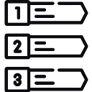
We completed 3 bodies of work in the past 2 months
Understand
Discover
Define
Extensive
Interviews & Analysis
We conducted Stakeholder, Seller and Farmer interviews to understand current state of the Lead Management process from all perspectives. We found several themes and opportunities for improvement
Blueprint with Opportunities
We laid out what we understood as the current state of the lead management journey from awareness to conversion. We layered in opportunities to improve and elevate the farmer journey
Roadmap & Recommendations
We prioritized these opportunities and categorized them into themes and initiatives. We developed a roadmap for implementation and additional recommendations to create KPIs to measure success.
Notes:
Quick slide on what we did, then move into why XX is so complex

Slide 7
How does this lead management work fit into XX’s overall Brand Strategy?
XX aims to deliver the #1 modernized farmer seed experience in agriculture.
Farmer Focused
Conversion Driven
Value Differentiated
The blueprint is from the vantage point of the farmer, highlighting pains and gains of their lead to conversion user journey
By focusing on the lead management part of the journey, we found areas of opportunity to drive acquisition and growth
Identifying marketing & sales opportunities to promote XX as a modernized, and personalized, brand of seed

Slide 8
What are the key opportunities for XX?

Slide 9
Lead Gen to Conversion is a less than
optimal experience
Business Process Definition
With siloed teams and a lack of ownership, there is an inconsistent workflow. This results in varying levels of documentation and accountability.
Low Automation in Complex Systems
With multiple internal tools requiring manual inputs, there is a known data quality issue. This results in duplicate or incomplete records.
Lack of Lead Segmentation
Leads aren’t being segmented or classified, with little to no process to follow up with interested farmers. This results in cold or lost leads.
Lack of Brand Awareness
The external brand messaging of the XX / XX differentiated value is lacking. This results in fewer organic leads and website traffic.
Notes:
Where is our process breaking down and making a less than optimal user experience?
Siloed teams
Lack of biz process
Terminology
Manual Inputs
Awareness

Slide 10
We uncovered 4 key themes of focus
Strategy + Change Management
Marketing + Engagement
Data + Performance
Tools + Technology
Identifying the expectations and clarifying ownership of the lead management journey at various stages
Enhancing the awareness and visibility of the brands while communicating differentiated value to potential customers
Qualifying and connecting data to various teams while tracking metrics to ensure success and increase lifetime value
Aligning tools and technology to business goals while creating automations to enable a more refined lead management journey

Slide 11
Strategy + Change Management
44
References in Interviews
There are gaps in the ownership and process that hinder leads from engaging with specific segments of the business.
Business Process
No clear accountability of ownership of the touch points in the journey
No documented activities and expectations of execution
An overwhelming system for managing accounts/contacts and prospects/leads
Confusing terminology that led to misalignment
No clear route for lead transitions through teams
Multiple ACURA segmentations
Siloed marketing and sales teams in process definitions/ownership
Limited access to information to all dealers
There's no business process. So I can do as much as I can with technology, but then, it kind of stalls at one point because there's no conversion from lead to actual account to create that sale. And I can't automate it based on the business rules that are there today.
Digital Fluency
Multiple tools being used to complete important tasks
Misalignment on digital tools and uses
Outdated/underutilized digital footprints to build brand awareness and engagement
Potential to further review XX's current digital strategy with technology industry trends
Sales Engagement
No clear programs to support Sellers in lead generation
Notes:
[Justin Welch] "they need their own silos and they need their own prioritization and they need to know what they're, what they're leading in each part of the organization so that they can be synergistic together instead of being more confrontational" - CX JustinWelch
[Jim Shertzer] "So one would be the whole like process of handing off a qualified lead to a sales team and then the sales team have an accountability that to then follow up with that customer and keep in that communication loop between the different organizational functions of where that customer is in the journey." - CX JimShertzer
References were all pain points and included topics: Manual Process, Org Complexity, Accountability, Change Management, Misalignment and a couple others

Slide 12
Marketing + Engagement
35
References in Interviews
There is a lack of communication and engagement with farmers outside of current customers.
Marketing Campaigns
I think our biggest risk is, we don't generate a ton of external leads right now. We just don't have a lot to come in to fill a funnel with willing prospects, we just don't get a lot, right? And then, we don't have a ton of visibility. So I don't even really know how fast we do get to them, OK, Who gets to them, how fast? It's just really, really opaque. The lead has to get to the seller who's gonna do something with it fast.
No marketing campaigns to engage potential farmers
No logic or routing of leads into segmented marketing campaigns
No engagement with farmers who download the XX app
Limited marketing to segmented accounts
Promotions + Materials
Limited local marketing
Limited Social Media presence and engagement
Siloed websites/brand pages from XX main website
Limited marketing materials on brand differentiated values
Marketing Forms
Inconsistent location of forms on brand sites
Lack of form fields to identify XX farmers
Basic forms not gathering proper information on farm operations
Notes:
[Justin Welch] "We've got to figure out how do we get more exposure so that we have leads actually coming in and that we can follow up on. I mean I just found out today that our contact us form on the on the website is broken. Nobody knows how long. The only reason we found out was somebody was calling. They didn't know how to call support so they hit that link and the form was broken and nobody knows how long it's been broken or why it was broken. We but it's broken so it doesn't get used every day. Somebody's got to dust off the cobwebs to gotcha for the lead generation to start the process because people aren't discovering us and and some of that will be is when they do start discovering us because we decide to do something innovative" - CX JustinWelch
[Morgan Dugan] "I think our biggest risk is just, I mean, we don't generate a ton of external leads right now. We just don't have a lot to come in to fill a funnel with with willing prospects, just don't get a lot, right? And then you know, we don't have a ton of visibility. So I don't even really know how fast we do get to them, OK, Who gets to them, how fast? Like, it's just really, really opaque. But no, OK, just the the lead has to get to the seller who's gonna do something with it fast." - CX MorganDugan

Slide 13
Data + Performance
40
References in Interviews
There are gaps in data management and data quality that hinder trust in performance metrics.
Segmentation + Profiling
No qualification criteria for leads or sellers
Different “ACURA” segmentation in various teams
No factors to un-qualify a lead
No clear XX segmentation and validation
I would say there's like pieces of the data that reside in so many different places. So if I want a list to use for something, it's like part of the contact might reside in one place, part might reside in another. Whether or not they're actually a targeted segment lives in another tool. There's just a lot of manual list building.
Business Data
No consistent tracking of conversion rates based on the lead to conversion funnel
Limited tracking of farmer touchpoints
Limited KPI Reporting and analysis
Limited methods of gaining farmer feedback
Data Quality
No process for data cleansing and audits
Limited data validation with leads/contacts/accounts
Limited data visibility and connectivity to key teams
Notes:
All of the data that we've put together today, I can tell you which campaign they came in from, which website they came in from. I can tell you how many are leads versus how many are contacts. I can tell you how many times we've talked to them. But all of that data is everywhere. It's all manual to pull.
[Lauren Atcher] "Right now it's disjointed. There is no connection point unless like myself or somebody that knows the systems is going in and doing it. Typical sellers, how they know how to create people is they go to crop edge, they enter somebody's name with their address, it's called search before create" - CX LaurenAtcher

Slide 14
Tools + Technology
15
References in Interviews
There is a lack of technology alignment that could create a more seamless journey for all roles.
Tech Features
Limited or no access to key tools for sellers outside of the org.
Limited access to backend data connecting to important tools to drive sales
Limited use of the XX app in the lead generation process
There is some technology limitation to the Salesforce lead generation, meaning to be able to tell who you are. So today, it's setup to only look at your email and connect you either with a contact or a lead. So because you might be already a contact in our system and we just didn't know that. To me that's a flaw 'cause we have so many duplicates.
Automations
No automated system to send leads to qualified sellers
No automation of creating ZD relationships within XX’s systems
No automation flow for marketing to segment leads into various campaigns
No triggers to move leads through the lead generation based on actions and inputs
Design System
No clear cross branding strategy on websites
No User Experience foundations to drive more Call-to-actions on sites
Limited user interface that dilutes brand messaging and position.
Notes:
[Lauren Atcher] "And then that's where the process of manually somebody, some human interaction has to happen to say, well which contact out of those five is it supposed to be? So that's a limitation that I'd like to tackle on the technology side for sure. And then additionally, it's just the business process side of it of OK, if it even if it wasn't a known person and I am literally net new, I have never been seen anywhere in the system. There's nothing converting me from a lead to an actual account" - CX LaurenAtcher
[Heather] "So as far as metrics, there's also click but but Marketing Cloud isn't sending information back to Click yet. There is work in doing that we're we're hoping to kind of incorporate all those tools together into one, but that hasn't happened yet." - CX HeatherRhoden
[Jim Shertzer] "t's just kind of pulling the string tighter through the journey through the systems through like the process those kind of that's where I think we've you know we've we've got some of these things but we're not. We're not syncing, syncing them all up to work hard for." - CX JimShertzer

Slide 15
Solutions to simplify these complexities + address critical areas
Enhanced
Marketing
Data
Quality
Technology Alignment
Strategy and Change Management
FOUNDATIONAL
Given the potential amount of organizational change, Strategy and Change Management (which includes some levels of data governance) is going to be a key driver in the recommendations. We see it as the foundation for success in XX’s lead generation to conversion efforts.

Slide 16
A holistic approach to lead management success
Strategy + Change Management
Marketing + Engagement
Lead Success
A service blueprint is intended to find opportunities in the holistic process, not just one main area. Many of our findings did overlap in certain themes, which means the workstreams should collaborate and work together while implementing the solutions.
Data + Performance
Tools + technology
All of the areas will work together to create a more streamlined, automated approach to lead generation, while strengthening the foundations needed for sustainable growth moving forward.

Slide 17
Understanding
the Current State
Executive Summary | Understanding the Current State | Mapping the Service Blueprint | Crafting a Future State | Complete Ecosystem for Success | Next Steps | Appendix
Click the white circles above to navigate to the desired section
Notes:
Madison

Slide 18
Understanding the factors limiting and accelerating the lead to sales conversions
Conducted Stakeholders Interviews
Collected common themes and gathered what success meant to various roles across XX
Conducted Seller & Farmer Interviews
Building empathy for our main actors in the lead to conversion journey
Collaborated through Workshops
Bringing alignment on our strategic direction and defining metrics for success

Slide 19
Stakeholder Interviews
8
Marketing
Automation
Sales Management
We spoke to 8 stakeholders to get better understanding into the current process from various team perspectives
Through our discussions, we identified pain points, opportunities, and complexities that various stakeholders encountered with the current XX/XX Lead management process.
These conversations provided valuable insights into the functional steps being taken and the backend platforms where data is captured for each of these activities
XX Specialist
Brand Marketing

Slide 20
Themes we heard…
During the stakeholder interviews, some common themes occurred.
Lack of Awareness Top of the funnel marketing has been limited, with inconsistent and minimal messaging about the brand
Many Internal Tools There are a high number of tools used throughout the lead gen to conversion process, but mostly for internal usage only. Tools also can be disjointed in many areas.
Siloed Teams Teams aren't communicating to each other effectively. Each may be aware of their own responsibilities, but often aren't aware of the system as a whole
Lead Information While we are collecting information on leads, they aren't actively being looked at and there is a desire to grab more information to help sellers
Manual Inputs There are several sales and marketing touchpoints that can be automated and don't need human input to execute
Lack of Business Process Definitions There is lack of ownership on different steps of the process. There isn't a clear workflow implemented displaying key activities and accountabilities for the business process
Lead Follow Up There is a need and a desire to have a consistent process to follow up on leads and report on sales funnel progress
Terminology Misalignment Terminology used along the lead gen to conversion process is spoken about differently depending on where you sit in the organization
Data Quality + Management Team perspectives on lead management are influenced by data quality concerns, stemming from inconsistent data entry processes.
Notes:
Where is our process breaking down and making a less than optimal user experience?

Slide 21
Considering complexities
So right now, if it's a lead, nobody's talking to them.
The ability to lose their startup mentality is very tough and part of that start up mentality is the ability to think as the consumer is evolving. That's why you're able to succeed when larger corporations can't make that adjustment… we have a wanting but maybe not quite a willingness yet to bridge that gap.
Isolated activities, manual processes, missing data, lost engagements, organizational blockers…
As XX is aware, they have some unique complexities that they face as an organization. These same challenges that present themselves in different areas of the business can also be seen within the lead management journey. Not only internally but also externally for users or resellers.
Being able to identify and ultimately visualize these gaps enables us to identify their impact and bridge the disparities in both front stage and back stage experiences.
The business process has not been defined of who owns the actual manual conversion because you can't automate… who owns that process from a business standpoint? … who's converting it to the account or in a contact and lead and an actual person?

Slide 22
Seller Insights
7
But if there's one thing that I've learned in the sales role is that while product and quality of product is important, people buy from people and they work with people that they like.
Themes we heard…
The importance of the Seller/Farmer relationship
Time constraints in lead generation/management
Sellers are providing their own value with supportive services.
Limited access to potential client information.
Learning the customer to provide a tailored experience is key to success.
Year one I was able to figure out within my customers, you know how does each customer really like to be treated? How do they like to be serviced? Do they appreciate frequent communication or do they kind of just want to be left alone and and only be only be talked to about really, really important things.
We gained insights from:
3 XX Certified Advisors
2 XX Sellers
1 XX Specialist
1 XX Sales Rep

Slide 23
Farmer Insights
5
I prefer in person interactions. I’ve known my seller for years. I knew him for four years before buying seed from him.
Themes we heard…
The importance of the Seller/Farmer relationship
Previous relationships with sellers prior to purchasing.
Time constraints in meeting with sellers to go over purchasing options/information
Prefer more personal interactions over email.
Providing referrals to other farmers
But I gave my XX person the ability to go into my John Deere and grab all my maps. So he took all my maps out of my John Deere and got him put into XX. And then we started building recommendations based on which fields I told him that are going to be Golden Harvest acres and soybean splits.
We gained insights from:
3 XX Farmers
2 XX Farmers

Slide 24
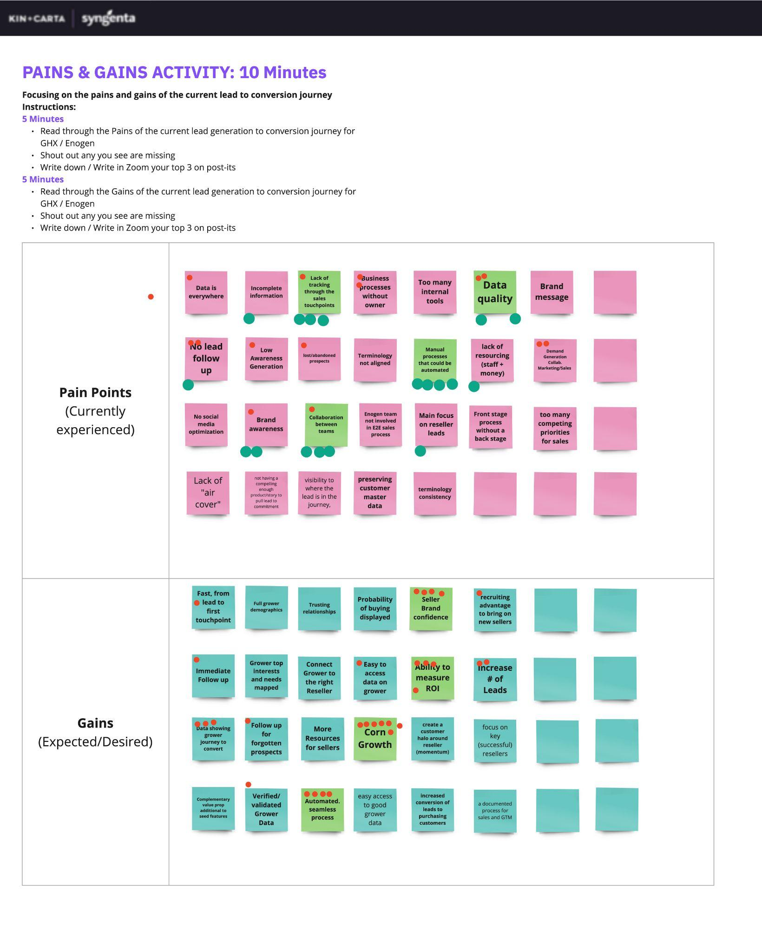
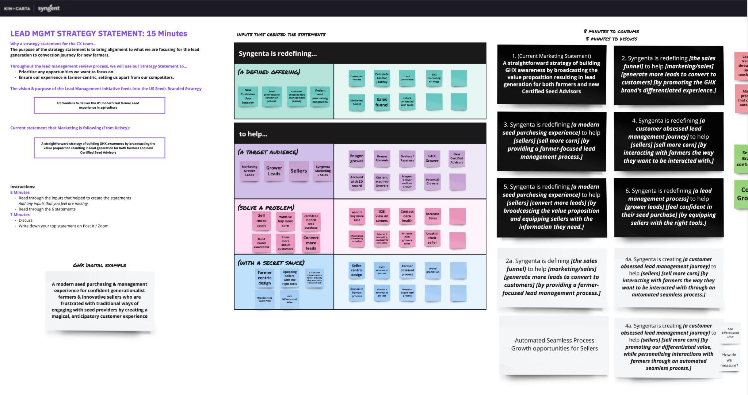
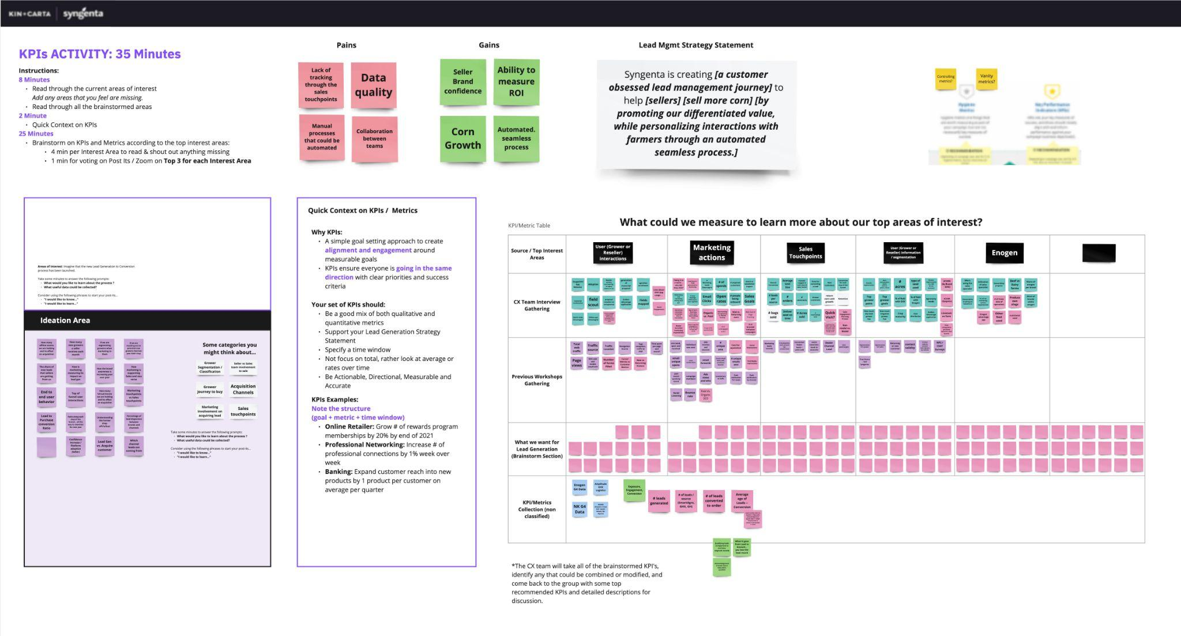
We partnered on a Workshop to define our direction
Link to Workshop | PW: SynCX2024
We met with Key Stakeholders and special guests to align on our strategic direction and define metrics for success.
This included various teams that support the lead management journey and business leaders who brought their expertise to ideate and contribute to the discovery of the problem statement, the metrics to track success and the validation of key insights.
The result of this workshop was a clear understanding of the current Pains & Gains, the Strategy Statement and the Top Interest Areas and KPIs/Metrics associated.

Slide 25
In our workshop we covered…
Link to Workshop | PW: SynCX2024
Identify
Refine
Define
K+C
K+C and XX
K+C and XX
Interview Findings
Pains and Gains
KPI Definitions
Shared out our insights gained by interviewing stakeholders within XX that generated themes, successes, frustrations and ideas around the lead generation to conversion journey
Ideated around Pains and Gains of the current lead generation to conversion process
Discovered the main areas of interest that participants have in metrics that they want to see.
Created themes of KPIs and defined key metrics to bring clarity to the lead generation to conversion focus areas.
Strategy Statement
This isn't replacing or reinventing existing North Stars / Visions, this is specific to the blueprint work and prioritizing opportunities.

Slide 26
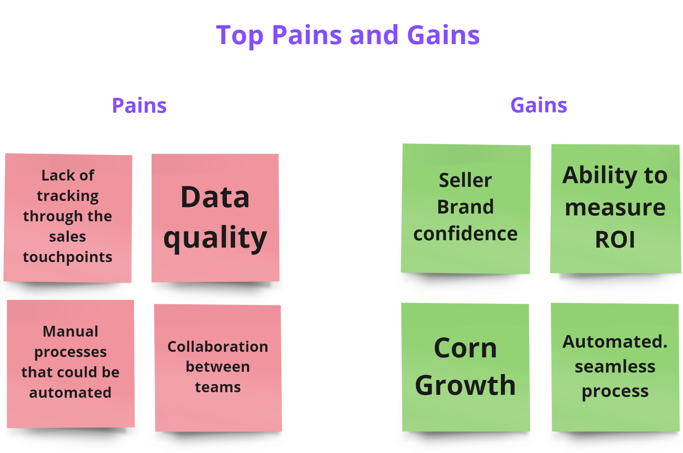
Pains & Gains
This exercise has the objective of identifying the current key Pain Points and Gains from the Lead generation to Conversion journey to further discover the problem statement
Pains
Pains currently experienced in the Lead generation to conversion journey, including lack of tracking the lead through touchpoints and data quality.
Gains
Gains that are expected or desired in a future state of the Lead generation to conversion journey, especially larger goals including brand confidence and corn growth

Slide 27
We aligned on a Lead Management Strategy Statement for the Farmer experience, to help inspire and guide our decision making:
XX is creating a customer obsessed lead management journey to help sellers sell more corn by promoting our differentiated value, while personalizing interactions with farmers through an automated seamless process.
Notes:
Madison

Slide 28
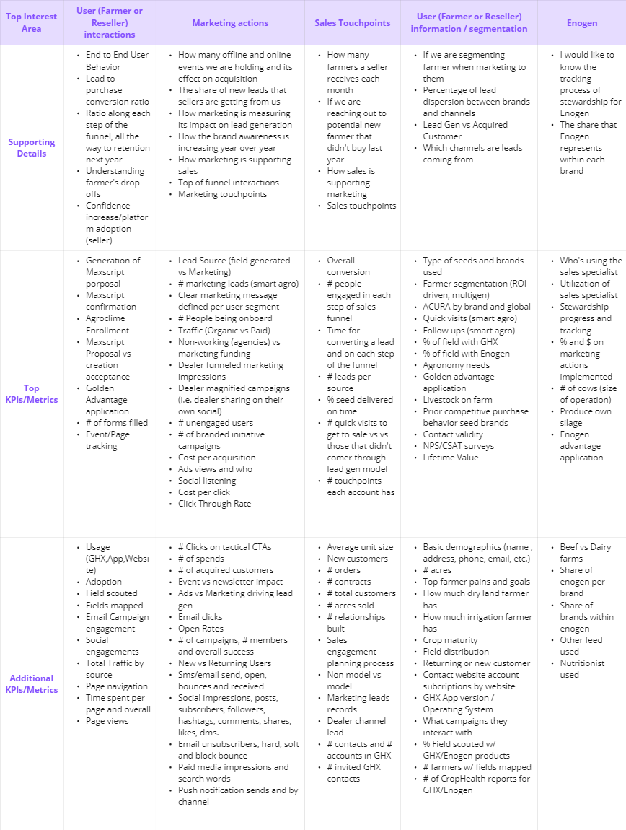
KPI Definitions
Top Interest Areas
Participants were asked about their Top Interest Areas regarding the Lead generation to conversion journey, asking what they would want to learn about the process and what useful data could be collected. These insights allowed us to create themes to group the KPIs.
KPIs/Metrics
Each interest area was then brainstormed on the full list of KPIs and Metrics that could be used to learn more about it and contribute answers to the current state of the problem statement

Slide 29
Mapping the Service Blueprint
Executive Summary | Understanding the Current State | Mapping the Service Blueprint | Crafting a Future State | Complete Ecosystem for Success | Next Steps | Appendix
Click the white circles above to navigate to the desired section
Notes:
Madison

Slide 30
Service Blueprint - The ‘Stages’ of Service Design
Customer’s behind the scenes: The things you can’t control that happen before, after and around an interaction, shaping the customer’s perceptions and experience.
Front stage: Everything that is managed by the organization and is visible to the customer, both digital and human.
Line of visibility:
Separating service factors that are visible to the customer from those that aren’t.
Back stage: Everything that is not visible to the customer, but is still felt: processes, infrastructure, training, etc.
Organization’s behind the scenes: What the organization can and can’t do. The guiding principles, culture, organizational structures, etc.
Customer’s behind the scenes
Front stage
Back stage
Organization’s behind the scenes
Notes:
These stages highlight the depth of engagement and processes happening as a user engages with a brand/business.

Slide 31
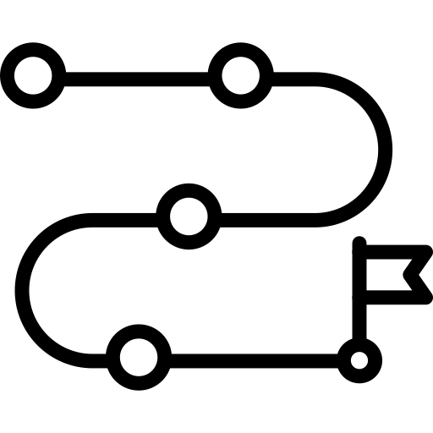
What a CX Blueprint outlines
The User Journey
The Supporting System
Business Processes
The blueprint highlights the current user journey for the main actor. The journey also showcases all of the actions of any supporting roles.
The tools that either enhance or limit the process are mapped out. Both the front facing tools and the backend foundations to support it.
The triggers that enable the actions of the user or tools to complete the actions.

Slide 32
We analyzed our findings to build the XX & XX Lead Management Blueprint
Identified
Actors
We identified several main and supportive roles that impact the progression of lead management from initial awareness to conversion.
Determined
Journey Phases
Defined the key phases of the journey and how they relate to the customer classifications during the sale process
Built
Service Blueprint
Once our blueprint structure was in place, we built and refined the current state of the Lead Management process

Slide 33
Role Definitions
XX Farmer
One of two main actors in the journey that we want to highlight. Starting with their initial awareness of the brand through the subsequent purchasing and receiving seed.
XX Farmer
One of two main actors in the journey that we want to highlight. Starting with their initial awareness of the brand through the subsequent purchasing and receiving seed.
XX Certified Advisor and Specialist
These sellers have the first direct line of interaction with farmers. They provide knowledge and expertise, while conducting business on behalf of XX. Additional certification is needed to sell XX.
Defining the Main Actors
There are key players that have an important part to play in the lead management process. To truly understand the holistic journey from both the front stage and backstage, we identified several main and supportive roles that impact the progression of lead management from initial awareness to conversion.
Marketing
The team responsible for awareness and brand messaging.
Sales/Business Operations
The teams supporting the Certified Advisors and Specialists, while defining and tracking XX sales targets.
Technology
Systems and tools that inform, engage and facilitate the journey on behalf of all of the other actors within the process.

Slide 34
Lead Segmentations
During our discovery, we noticed that there was a distinct difference in how certain leads moved through the conversion process.
Marketing Lead
This is defined as a lead that finds the brand organically, and submits an interest form on a brands perspective website.
Marketing Leads are not communicated to beyond submitting an inquiry on the brand site.
There is no current system to engage with these potential farmers (Leads)
Seller Driven Lead
This is defined as a lead created from the relationship built between a seller/dealer and the farmer.
While touchpoints and other sale activities are taking place, they are not documented or consistent across sellers.
Dealer Channel Lead
People that are actively being recruited to sell seed through one of XX’s go to market channels.

Slide 35
Journey Definitions
We translated the sales conversion pipeline to phases within the CX Service Blueprint. This helped us understand how each lead transitioned to the next steps towards making a purchase.
Awareness
Interest
Consideration
Conversion
& Loyalty
Pre-Lead: Farmer is either unaware, or just becoming aware and engaged with XX / XX.
Lead / Prospect: Lead farmer is someone who has expressed interest in XX / XX, but does not have an account in the system. Prospect farmer has an account within XX, but has not purchased in 2+ years.
Account / Contact: When a farmer is entered into the XX system, they must have an account first. A contact is the ‘individual’, while an ‘account’ is the entity.
Customer (Order): The conversion point when a farmer Account places and order with XX / XX

Slide 36
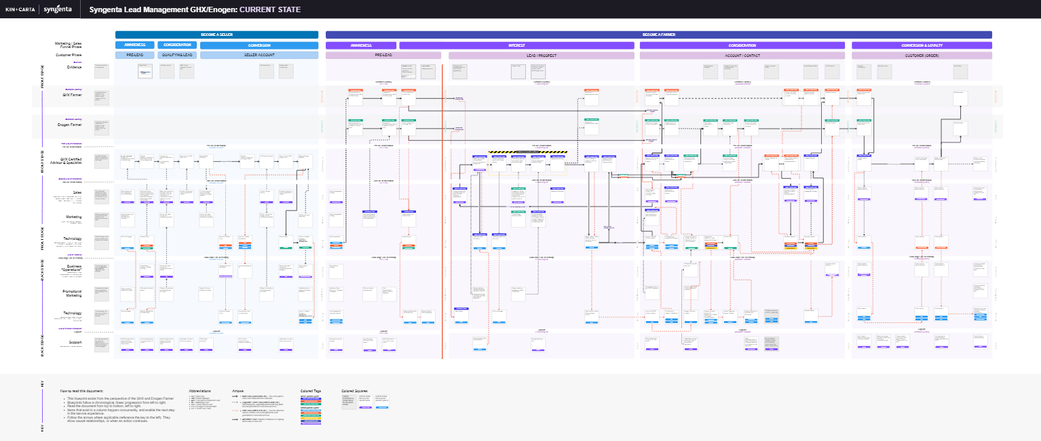
XX’s Lead Management Blueprint- Current State Only

Slide 37
How to read the Lead Management Blueprint
Link to Blueprint | PW: SynCX2024
Blueprints follow a chronological, linear progression from left to right. Read the document from top to bottom, left to right.
Items that exist in a column happen concurrently, and enable the next step in the service experience.
Squares define artifacts, actors and systems that highlight actions during the journey.
Tags and Abbreviations identify specific roles, lead types and tools that complete an action
This blueprint exists from the perspective of the XX Farmer and the XX Farmer. It also highlights the conversion process for Dealer Leads.
The primary flow of the process is highlighted by the solid black line.
It was important to also show the actions directly supporting the lead generation process along with how information flowed throughout the journey

Slide 38
Crafting the
Future State
Executive Summary | Understanding the Current State | Mapping the Service Blueprint | Crafting a Future State | Complete Ecosystem for Success | Next Steps | Appendix
Click the white circles above to navigate to the desired section
Notes:
Madison

Slide 39
We partnered on areas of opportunity across the journey
Opportunity Framework & Ideation
We gathered all of the ideas generated around the lead management process from interviews, and gaps within the service blueprint.
Identifying Initiatives & Epics
We grouped opportunities into key focus areas to help identify themes and initiatives around the ideas we had collaborated on.
Prioritization & Initiative Scorecard
We partnered with our main stakeholders to assign value and effort to our initiatives, used frameworks to prioritize and build an Initiative Scorecard to summarize this process

Slide 40
Opportunity Framework
The Team decided to ideate and classify the opportunities found for the current lead management process as follows:
New Opportunity
A gap in the process, activities or actions that does not currently exist in the Lead Management process
Enhancement Opportunity
An existing activity, action or tech that needs additional elements to make true impact
Simplify / Automate Opportunity
An existing activity, action or tech that should be automated of simplified
Alignment Opportunity
An area in the process that could be better aligned with a different brand or activity

Slide 41
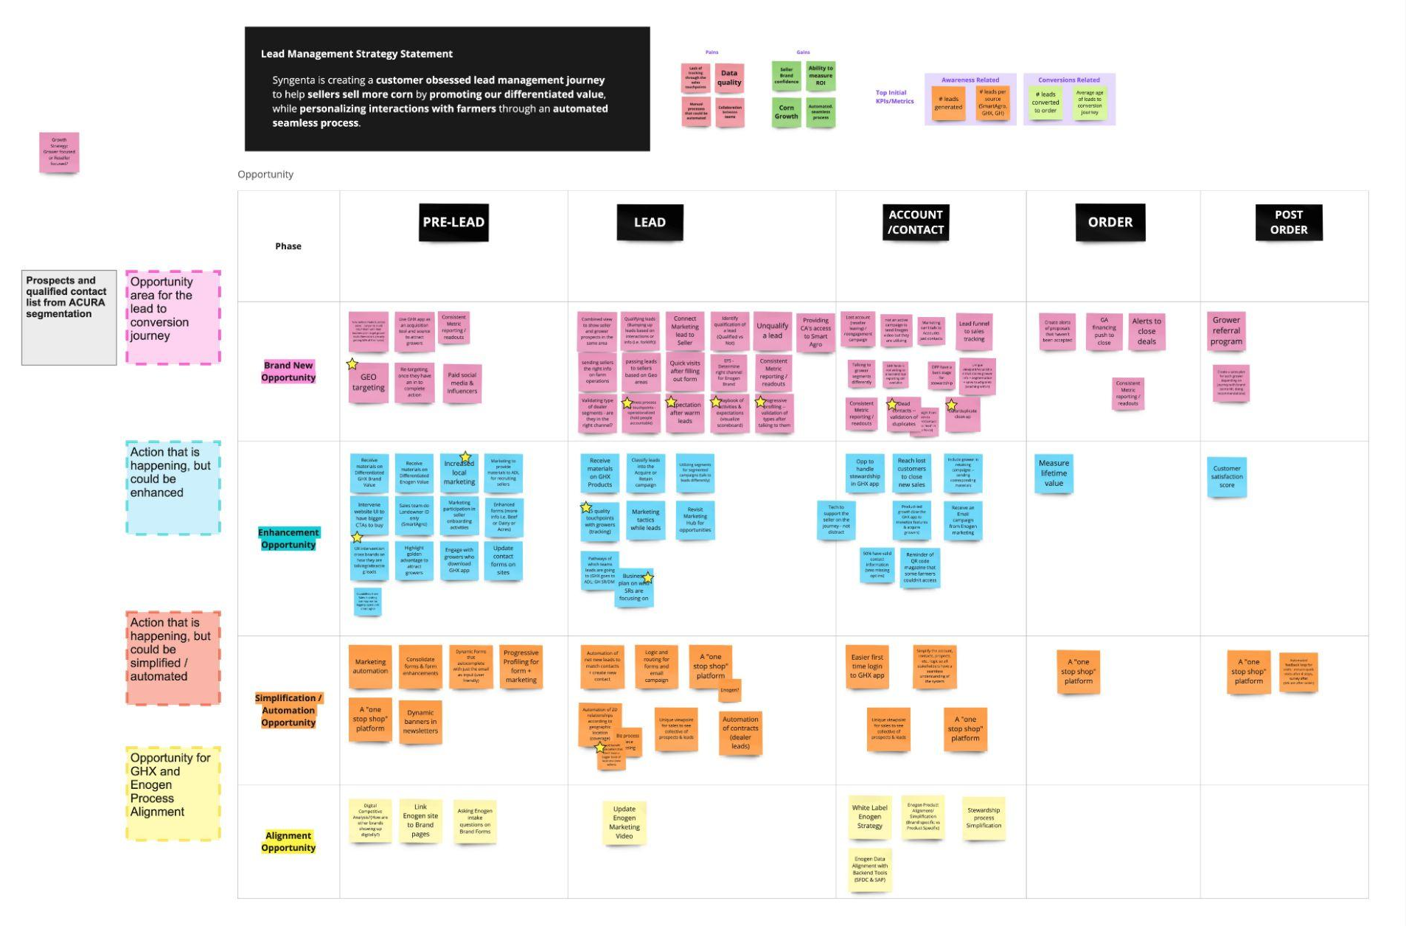
Opportunity Ideation
We met with Key Internal Stakeholders to ideate on opportunities areas across the lead generation to conversion journey.
This included feedback from stakeholders, insights from the seller/farmer interviews and gaps within the service blueprint.

Slide 42
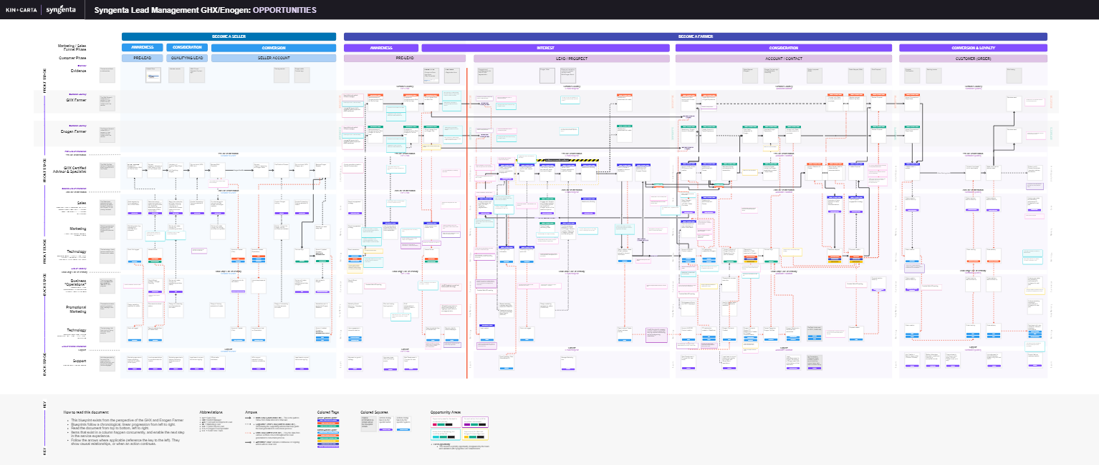
XX’s Lead Management Blueprint- Future State with Opportunities

Slide 43
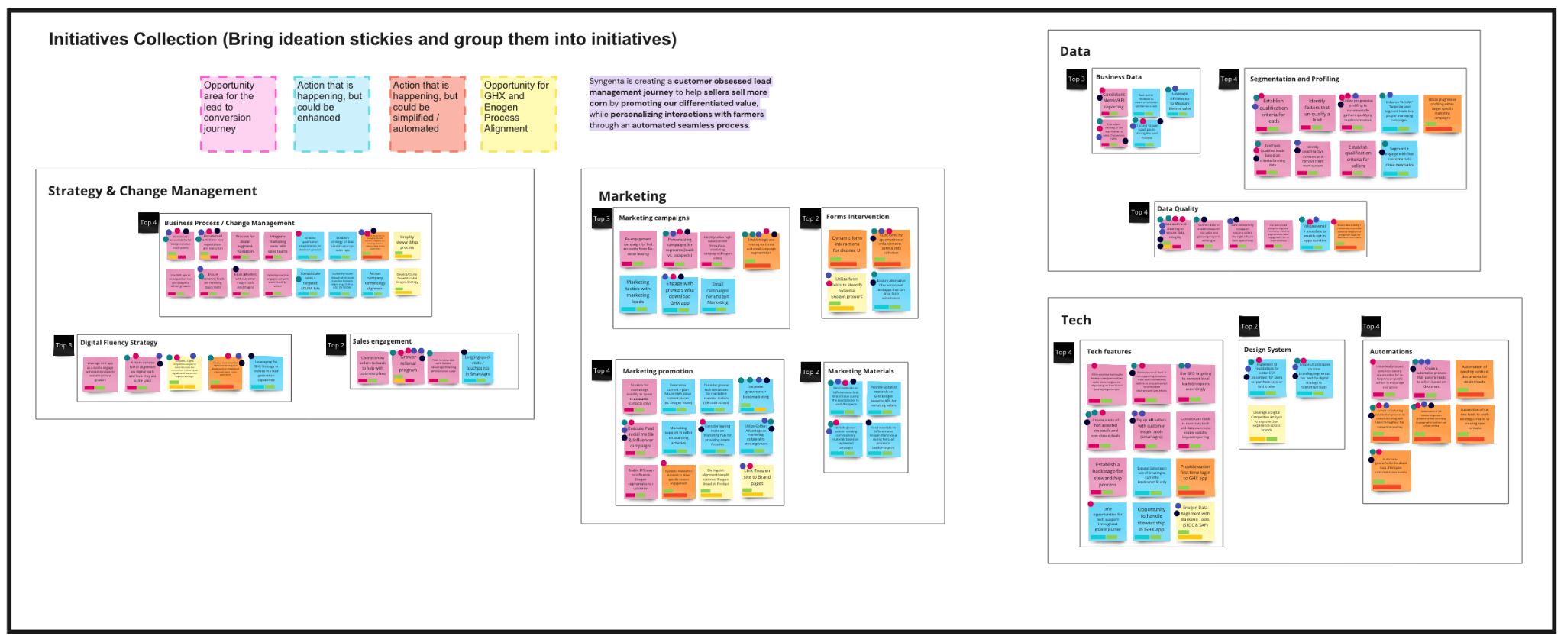
Initiative Collection
The Team used stickies to show the opportunities as Epics. Then, they were grouped into Initiatives and these were then collected into Themes.

Slide 44
Themes of Opportunity
Strategy + Change Management
Identifying the expectations and clarifying ownership of the lead management journey at various stages
Marketing + Engagement
Enhancing the awareness and visibility of the brands while communicating differentiated value to potential customers
Initiatives include:
Forms Intervention
Marketing Promotions
Marketing Campaigns
Marketing Materials
Data + Performance
Qualifying and connecting data to various teams while tracking metrics to ensure success and increase lifetime value
Initiatives include:
Segmentation and Profiling
Business Data
Data Quality
Tools + Technology
Aligning tools and technology to business goals while creating automations to enable a more refined lead management journey
Initiatives include:
Tech Features
Automation
Design System
Initiatives include:
Business Process/Change Management
Digital Fluency Strategy
Sales Engagement
Click on the arrow to see the initiative detail in the Appendix
Notes:
These activities led us to 4 main buckets of opportunities, from here we were able to begin ideating deeper into our initiatives and

Slide 45
Initiative Details- An Example
Theme: Theme Category
We created a detailed view of all epics underneath each categorized initiative. The prioritized epics show a detailed view of the opportunity category along with progress noted by the indicator.
Prioritized Epics
Other Epics
Epic | Tag | Progress
Prioritized Epic 1 | Epic Category
Prioritized Epic 2 | Epic Category
Prioritized Epic 3 | Epic Category
Listing of other epics that were not prioritized as a part of the initial implementation of this work. However, these additional epics should not be ignored when strategizing long-term plans for the success of the lead generation management process.
A detailed list of all of the initiatives and prioritized epics covered with the Service Blueprint work can be found in the Appendix of this deck.
Progress indicator
XX Complete
XX In Progress
To be started

Slide 46
Next, to prioritize through collaboration…
Identify
Prioritize
Consolidate
K+C
K+C and XX
K+C
Initiatives + Epics
Impact/Effort Matrix
Initiative chart with Scorecard
We established the key initiatives and corresponding epics based on the identified opportunities
Conducted high-level sizing initiatives, providing stakeholders with a structured approach to plan and prioritize their backlog of main actions in response to the problem statement
Exercised a structured approach for assigning priority to initiatives, scoring based on impact, effort, and confidence levels.
MoSCoW
Executed MoSCoW exercise to facilitate clear prioritization and decision-making, ensuring efficient execution of project tasks

Slide 47
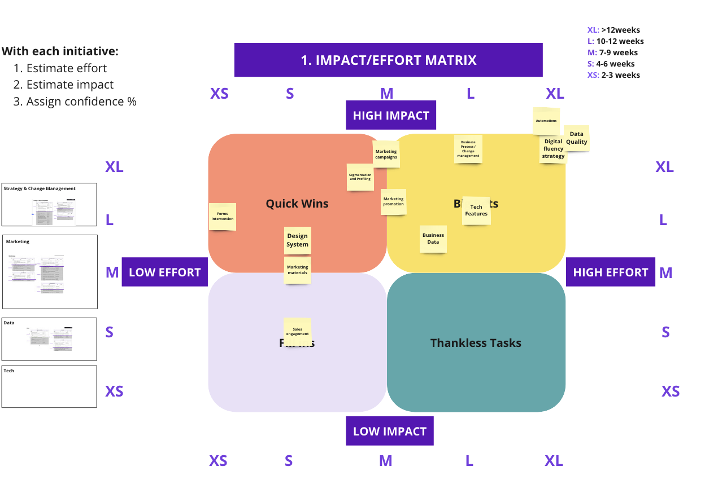
Impact/Effort Matrix
High-level sizing initiatives on their projected Impact and Effort provides stakeholders with a quick framework to plan and prioritize their backlog of main actions to solve for the problem statement.
High-level estimation: Assigning a T-shirt size for Impact and Effort allows stakeholders to have a first gut check attempt to define work
Understand the initiative quadrant: According to the Impact and Effort assigned, stakeholders can identify which are Quick Wins, Big Bets, Fill ins and Thankless tasks
Generate a scoring: To understand where to focus, this framework allows the generation of a score, assigning values to the T-Shirt size assigned to each initiative.

Slide 48
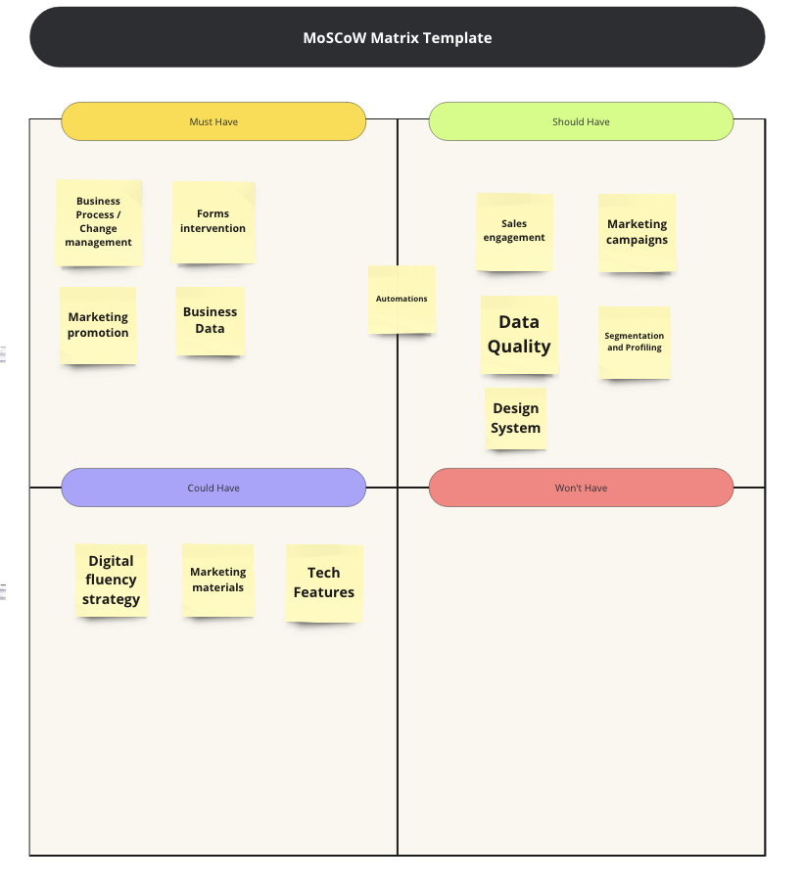
MoSCoW
Categorizing project requirements into Must-Have, Should-Have, Could-Have, and Won't-Have provides several benefits for efficient project management and decision-making.
Clear Prioritization: Intuitive method for prioritizing requirements based on their significance and impact on success.
Focus on Critical Deliverables: Must-Have criterias are essential and represent the core objectives.
Risk Mitigation: Identifying essential requirements early helps teams tackle risks and uncertainties promptly.
Alignment with Business Goals: Encourages stakeholders to align project needs with overarching business goals.

Slide 49
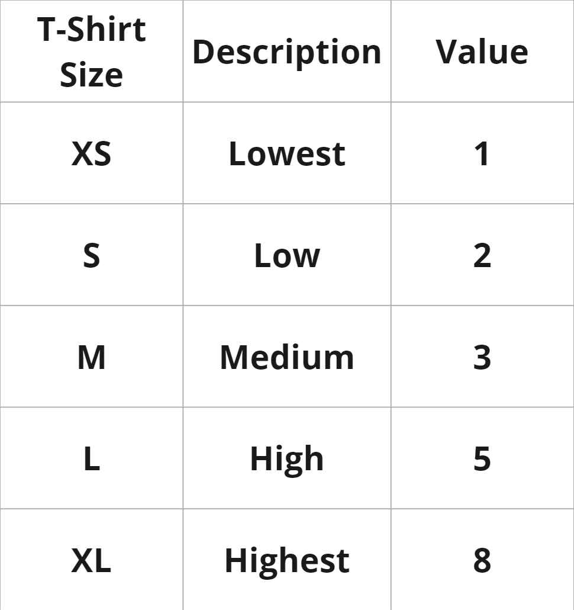
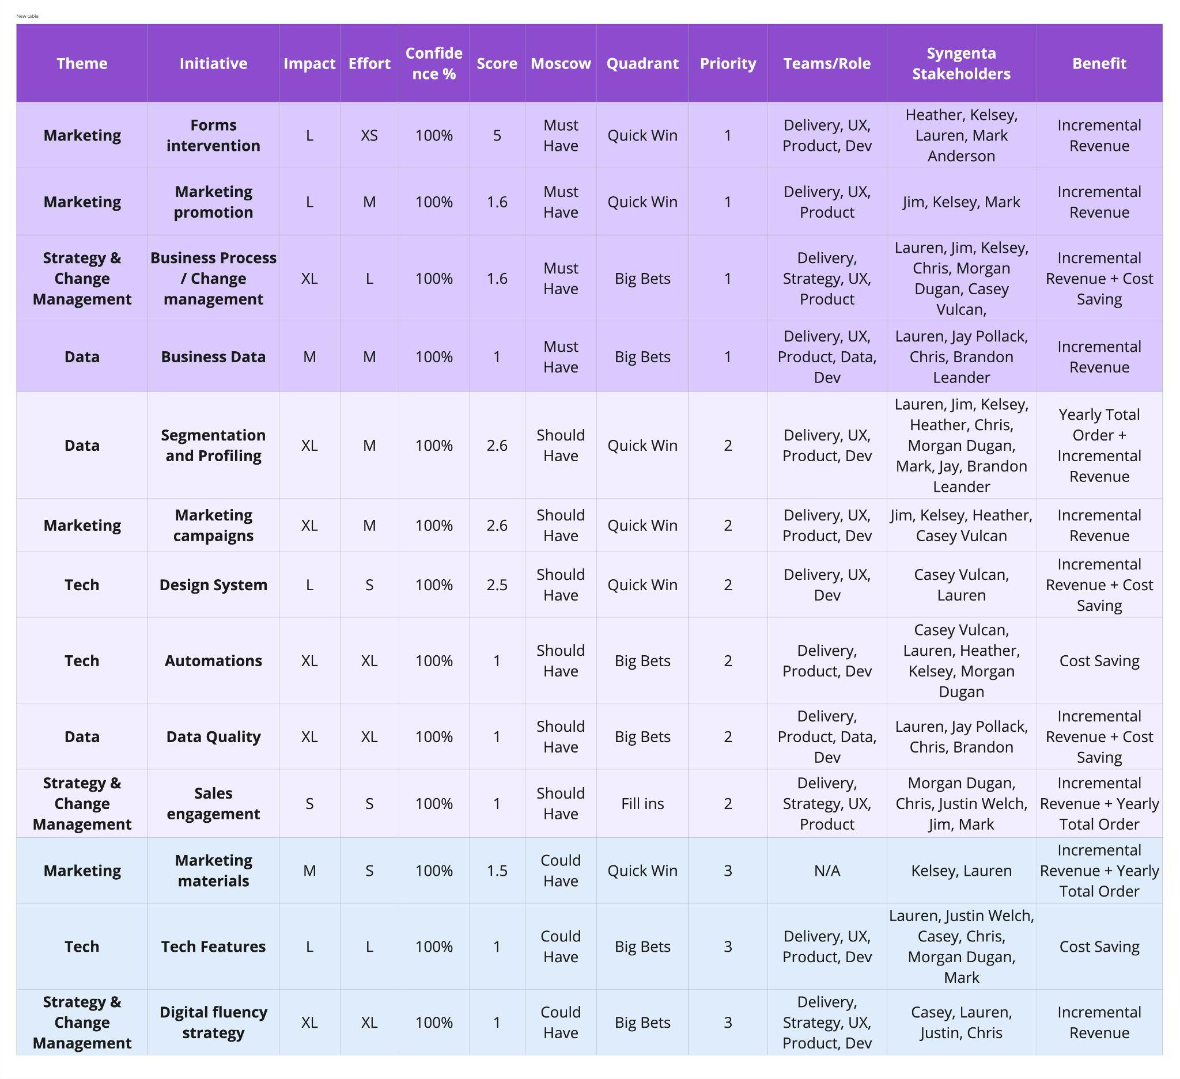
Initiatives Scorecard
Link to Scorecard | PW: SynCX2024
In order to combine and summarize both the Impact/Effort Matrix and the MoSCoW frameworks the Initiatives Scorecard was developed considering the following:
Way to assign Priority: Initiatives were first organized by MoSCoW (must have -> should have -> could have -> won’t have), then from highest to lowest score (score= (impact/effort)*Confidence). In case there’s a tie in scoring, the Quadrant would define priority (Quick win -> Big Bets -> Fill ins -> Thankless tasks) and for further prioritization the effort assigned was then used to defined order.
Ability to identify teams involved for each initiative: The scorecard allows to assign specific internal and external stakeholder that intervene.
Benefit Identification: Initiatives can also be associated to a direct organizational benefit

Slide 50
We aligned on what would the MVP would be and how to measure success
Initiative Scorecard success metrics, KPIs and suggested ROI calculations
Holistic roadmap based on Initiative Scorecard as a foundation for success.
MVP roadmap focusing on specific milestones and dates for completion.

Slide 51
The future state will enable
XX to:
Increase Revenue: By converting to customers the marketing leads available and leveraging existing marketing and technology
Save Costs: By improving and automating processes that require manual interactions
Increase Yearly Total Order: By increasing customer satisfaction and product cross-selling initiatives year over year.
Notes:
Brad

Slide 52
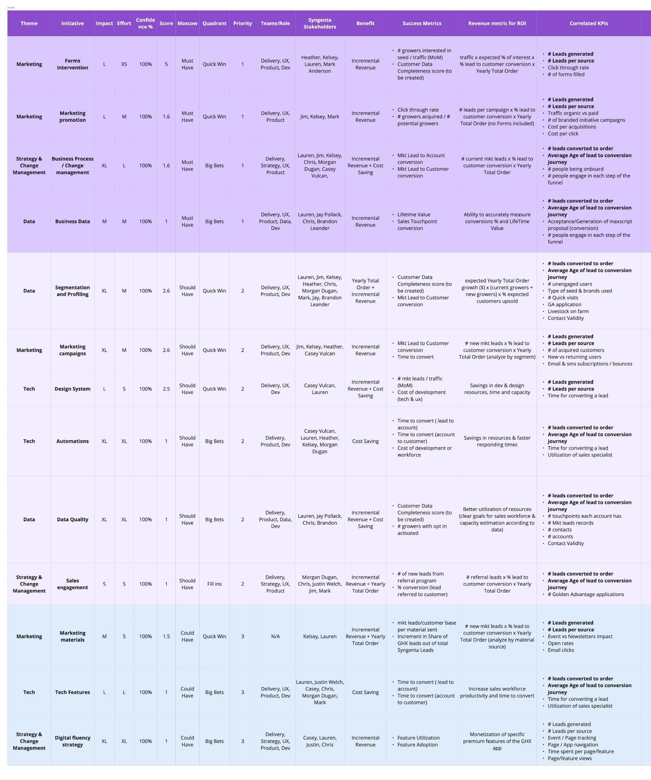
Expanded Initiatives Scorecard
Link to Scorecard | PW: SynCX2024
Using the former Initiative Scorecard, we decided to incorporate additional information that will help XX define feasibility and follow up of metrics
Success Metrics: These are the metrics that we consider are highly correlated and have causal relationships with the initiatives, so they key to measure the impact and success of implementation.
Revenue Metric for ROI : These are metrics that can be calculated in order to understand the estimated revenue impact each initiative will have when completed.
Correlated KPIs: These are the metrics that we consider are correlated with the initiatives, so they can also be used to monitor impact.

Slide 53
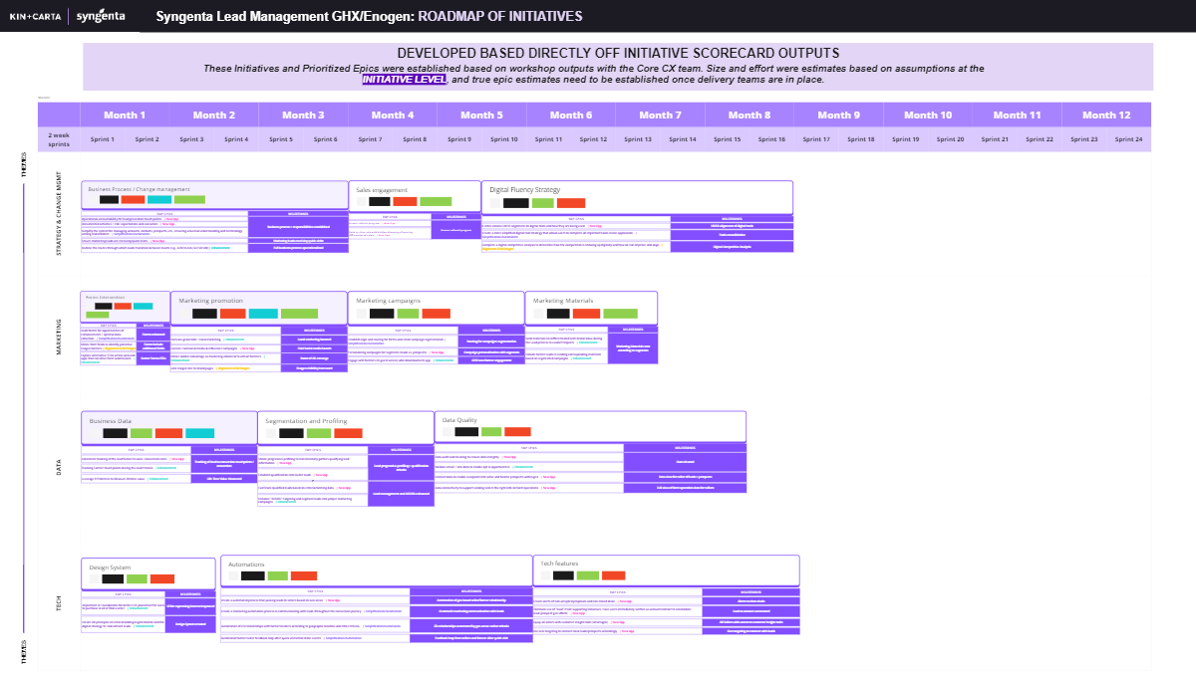
Holistic Product
Roadmap
Link to Holistic Roadmap | PW: SynCX2024
This holistic product roadmap was built directly off of the initiatives scorecard outputs
These Initiatives and Prioritized Epics were established based on workshop outputs with the Core CX team. Size and effort were estimates based on assumptions at the initiative level, and true epic estimates need to be established once delivery teams are in place.

Slide 54
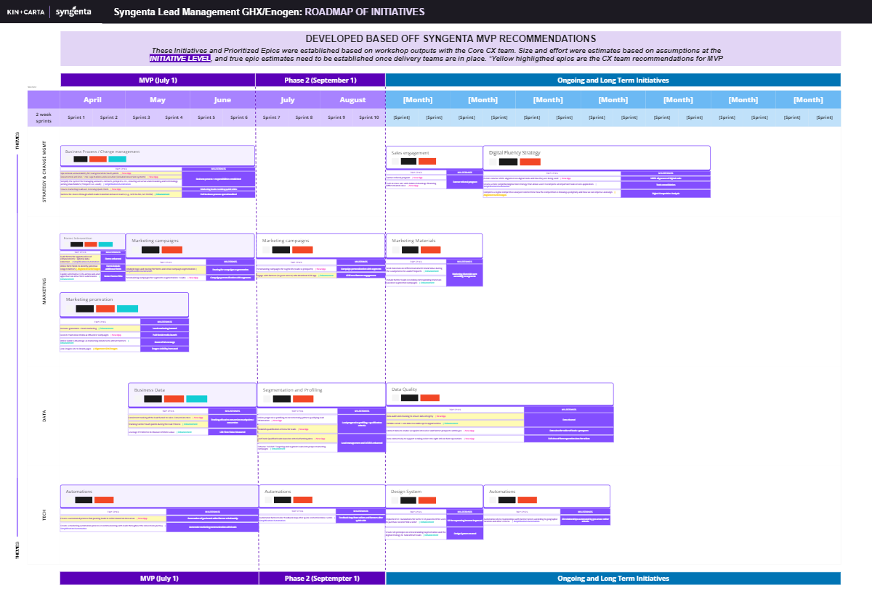
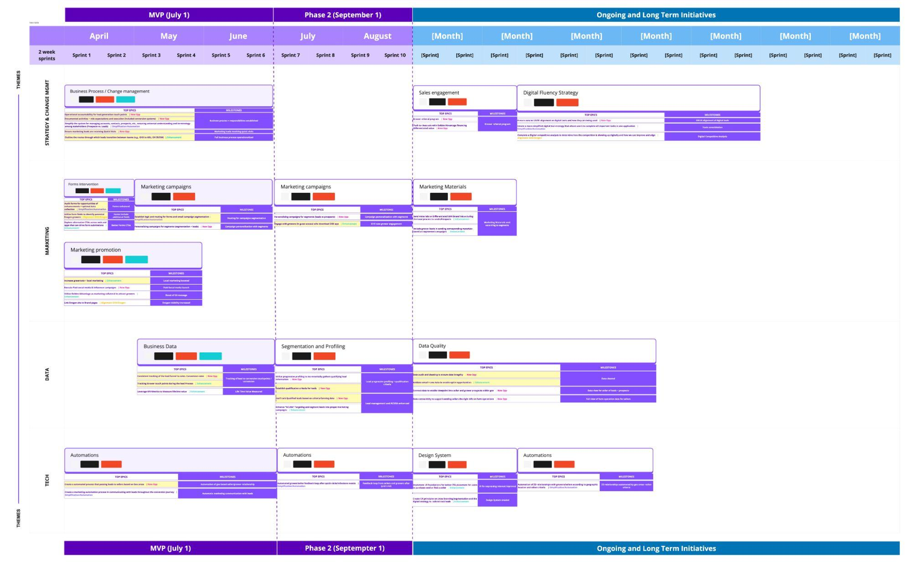
MVP
Product Roadmap
Link to MVP Roadmap | PW: SynCX2024
This MVP product roadmap was built directly off of the XX team’s recommendations. The items highlighted in yellow are our proposed definition of MVP, which we highly recommend executing as a priority.
These Initiatives and Prioritized Epics were established based on workshop outputs with the Core CX team. Size and effort were estimates based on assumptions at the initiative level, and true epic estimates need to be established once delivery teams are in place.

Slide 55
The future state will build upon our current successes and will make farmers feel:
Supported by the brand that values their needs while listening and understanding their concerns
Confident in their investment and know they made the right choice in a partnership for their farming operations.
Excited by the opportunities, levels of service and convenience that XX unlocks for their businesses.

Slide 56
Complete Ecosystem for Success
Executive Summary | Understanding the Current State | Mapping the Service Blueprint | Crafting a Future State | Complete Ecosystem for Success | Next Steps | Appendix
Click the white circles above to navigate to the desired section
Notes:
Madison

Slide 57
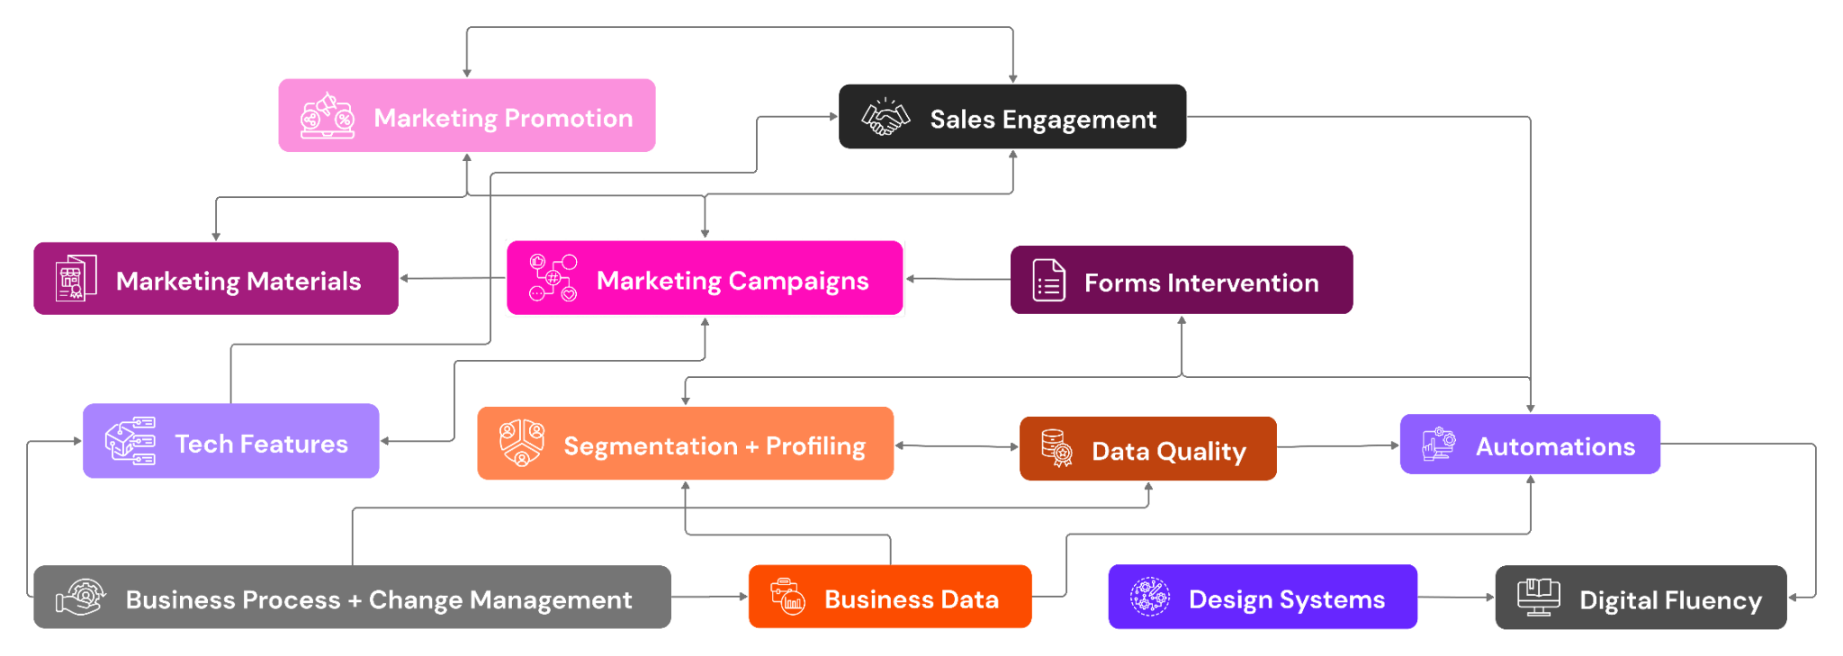
An Ecosystem of Initiatives
All of the initiatives live within an ecosystem that is constantly relying on each other to operate efficiently. This gives a view into why it is so vital to not lose sight of even one or two initiatives, as it will disable this ecosystem to perform to its full potential
Biz Process + Chg Mgmt
Marketing + Engagement
Data + Performance
Tools + Tech

Slide 58
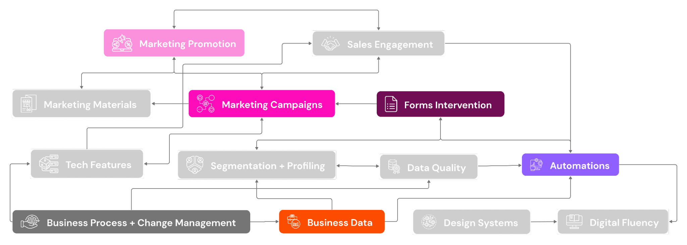
XX’s Starting MVP
These were identified as the priority starting points for XX and will provide a positive step towards the Lead Generation effort. Looking towards long term success, we can see the other initiatives that will continue the snowball of lead management transformation as well as the importance of continuing the work and ensuring these initiatives reach 100% completion
Biz Process + Chg Mgmt
Marketing + Engagement
Data + Performance
Tools + Tech

Slide 59
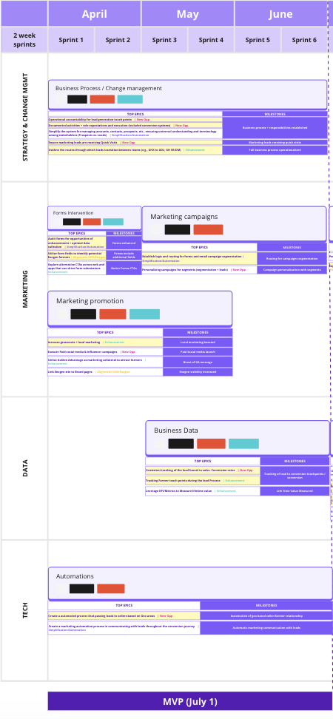
The critical role of completing all initiatives epics
It is easy in many instances to de-prioritize or lose sight of total achievement as you get farther down the stream with goals and initiatives on every type of project, it is no different and evermore vital when it comes to ones as large as lead generation.
Ensuring the completion of all epics within an initiative is essential for accomplishing a complete ecosystem that meets user and business needs comprehensively. Overlooking any epics risks leaving critical operations and functionality unfinished, which could hinder the success of the project.
Notes:
It’s easy when you do big audits like this to leave the engagement and start the process of tackling initiatives but as you get down the roadmap you start to lose sight of what the complete success looked like. Like any project or goal it gets busy and can be overwhelming so items are deprioritized or forgotten. Ensuring the completion of all epics within each initiative is going to be essential for reaching that complete ecosystem, that meets user and business need comprehensively. Overlooking any epics risks leaving critical elements unfinished, which ultimately could weaken the success of the project

Slide 60
Benefits that go beyond the obvious
Pursuing this complete ecosystem provides impact larger than lead generation…
Revenue Growth
Capacity for Innovation
Building Trust
XX has revenue sitting amongst their systems that is being lost due to gaps in process and resourcing. These initiatives are vital for current missed opps, but more importantly for net new lead generation and brand awareness
Streamlining processes and ensuring that you are truly addressing generated leads will enable marketing, sales and other teams the time to truly innovate. Less time spent on manual execution and gut checking data provides runway for XX to push the boundaries in the Ag industry
Not only will these initiatives provide customers with more support during their journey and give XX a stronger voice in the industry, but it will give internal teams the confidence to continue forging these relationships
Executing on marketing leads
Innovation
Data Reliability
Improved Productivity
Referrals + Lasting Relationships
Brand Awareness
Lead Quality
Manual Process Reduction

Slide 61
Next
Steps
Executive Summary | Understanding the Current State | Mapping the Service Blueprint | Crafting a Future State | Complete Ecosystem for Success | Next Steps | Appendix
Click the white circles above to navigate to the desired section
Notes:
Madison

Slide 62
Next Steps
The CX team provided a holistic view of the lead management process within the service blueprint. Opportunity areas were then prioritized at the initiative level, with a focus on MVP that should be delivered by key dates before the season starts. These are recommended next step to ensure delivery success.
Sprint Zero for MVP
Obtain appropriate resources for prioritized work
Confirm timeline of MVP & key milestones
Develop program & release plans
Identifying tasks for prioritized epics
Complete designs & write user stories.
Prioritize Epics
Track Success & Continuously Gather Feedback
The CX team prioritized at the initiative level. Now that the initiatives are ranked by impact / effort, that same exercise should be completed within the epics of each initiative.
This will help to build priority areas to continue to think about the entire ecosystem of initiatives.
Ensure metrics are put in place to track investment areas. Additionally, collecting user feedback is key to ensure continuous improvement

Slide 63
Thank you!

Slide 64
Appendix
Executive Summary | Understanding the Current State | Mapping the Service Blueprint | Crafting a Future State | Complete Ecosystem for Success | Next Steps | Appendix

Slide 65
Approach & Scope
Understand
Discover
Define
Understand the factors that are limiting and accelerating lead to sales conversions.
Kickoff meeting
Conduct 5 to 8 stakeholder interviews to align on the definition of success.
Conduct a KPIs workshop
Review CX and internal sales documents to identify gaps.
Participant recruiting (e.g., farmers and seed sellers).
Work Product:
Research discussion guide.
Pains & Gains, Strategy Statement and List of KPIs.
Build the Service Blueprint with a goal of identifying pain points and opportunities to increase the lead to conversion rate.
Interview up to 5 Seed Buyers and Seed Sellers.
Interview up to 5 XX and XX Farmers
Build and refine the Service Blueprint.
Work Product:
Service Blueprint document (from lead generation to conversion/farmer feedback).
List of lead to conversion journey KPIs.
Build a roadmap based on feedback and prioritize opportunities.
Use Impact/Effort matrix and MoSCoW as prioritization framework
Develop a score to prioritize and assign organizational benefits to each initiative
Develop a high-level ROI revenue calculation for initiatives and assign Success Metrics + Correlated KPIs.
Work Product:
Initiative Scorecard
Roadmap including MVP features.
Notes:
Here’s what we sought out to do

Slide 66
Simplified Blueprints

Slide 67
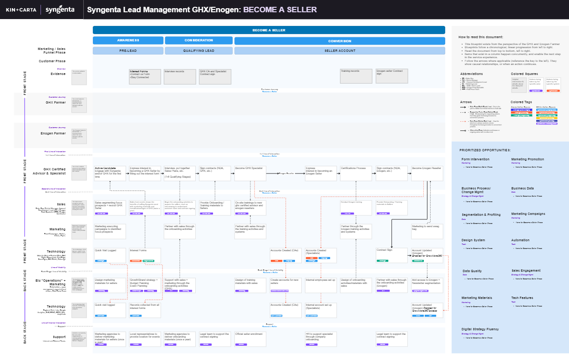
XX’s Lead Management Blueprint- Simplified: Become a Seller

Slide 68
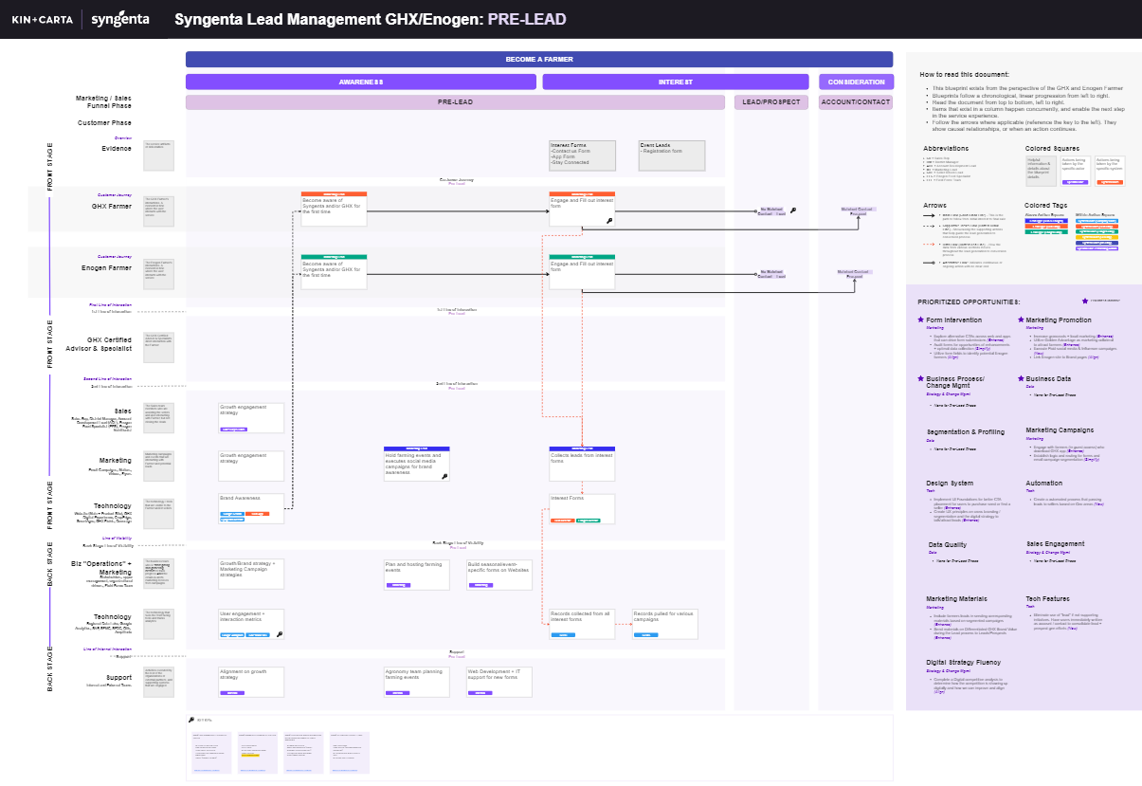
XX’s Lead Management Blueprint- Simplified: Farmer Pre-Lead

Slide 69
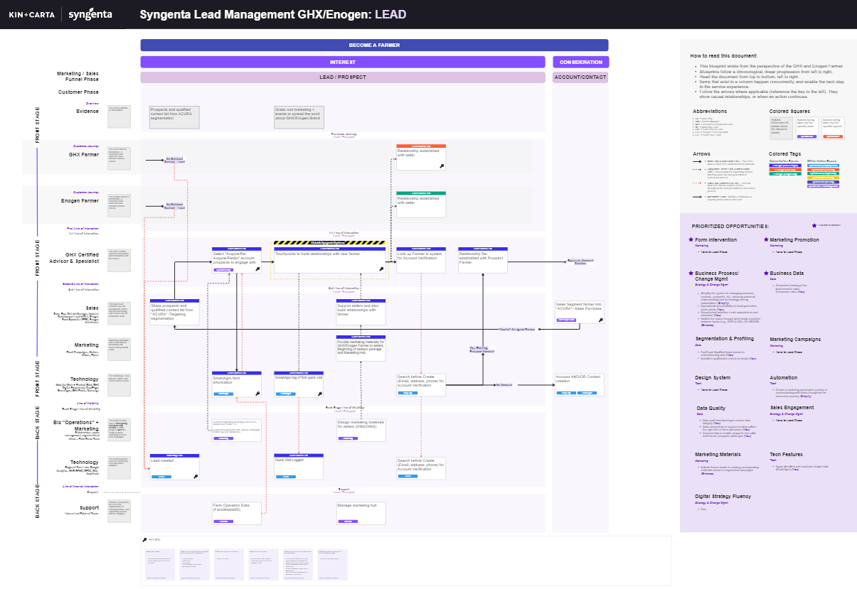
XX’s Lead Management Blueprint- Simplified: Farmer Lead / Prospect

Slide 70
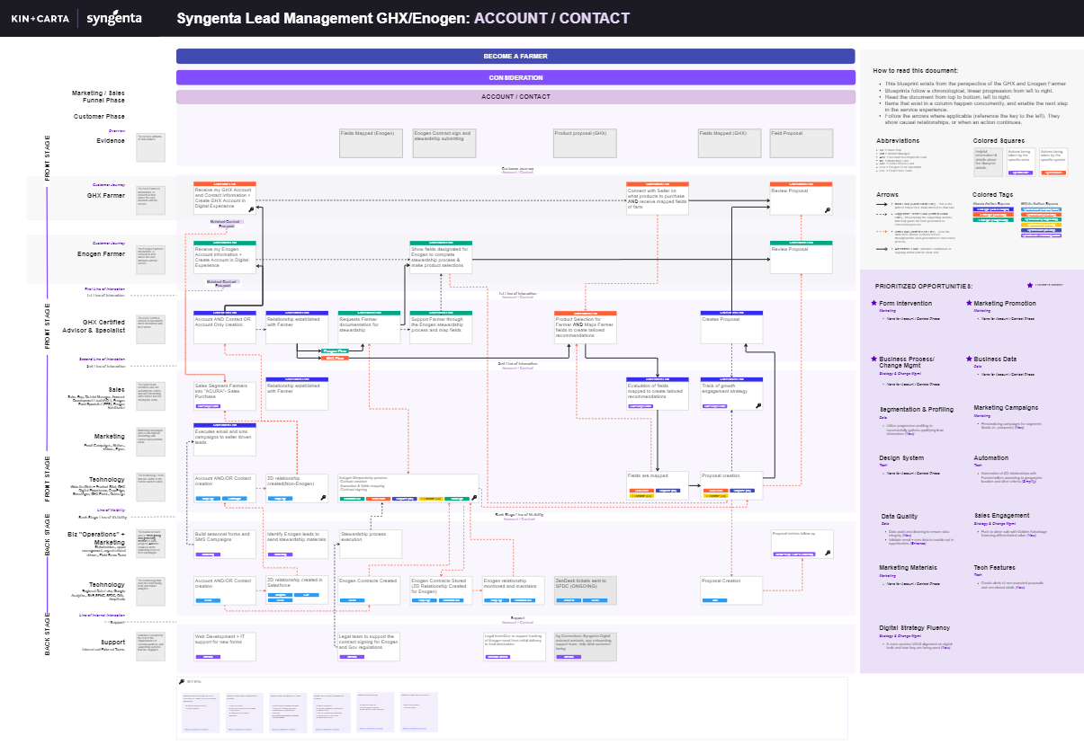
XX’s Lead Management Blueprint- Simplified: Farmer Account / Contact

Slide 71
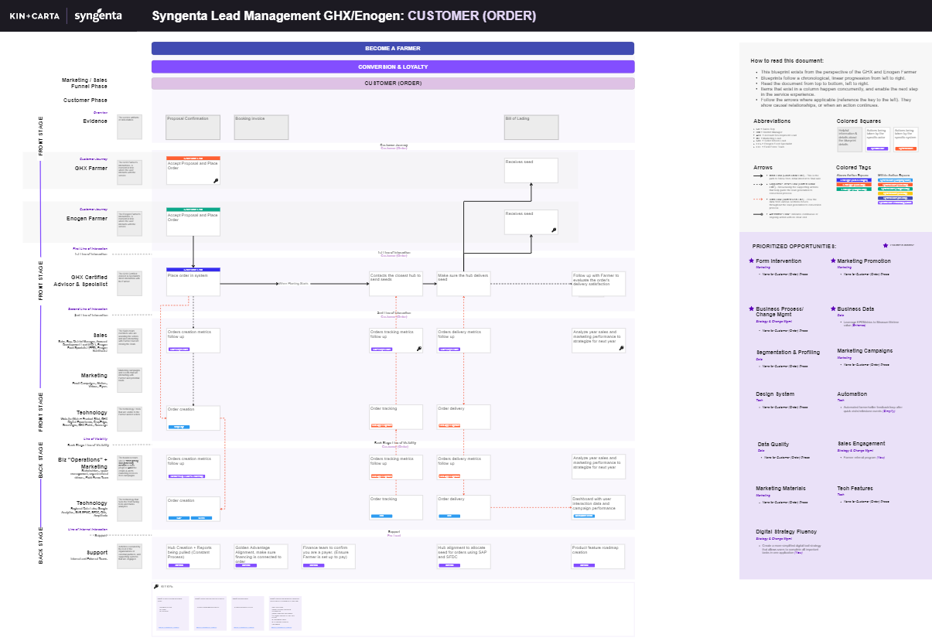
XX’s Lead Management Blueprint- Simplified: Farmer Customer (Order)

Slide 72
Epic Breakdown

Slide 73
Business Process/Change Management Details
Theme: Strategy & Change Management
Prioritized Epics
Other Epics
Epic | Tag | Progress
Operational accountability for lead generation touch points | New Opp
Documented activities + role expectations and execution | New Opp
Simplify the system for managing accounts, contacts, prospects, etc., ensuring universal understanding and terminology among stakeholders | Simplification / Automation
Ensure marketing leads are receiving Quick Visits | New Opp
Outline the routes through which leads transition between teams (e.g., XX to ADL; GH SR/DM) | Enhancement
Establish qualification requirements for dealers + farmers (Enhance)
Consolidate sales + targeted ACURA lists (Enhance)
Equip all sellers with customer insight tools (smartagro) (New)
Process for dealer segment validation (New)
Integrate marketing leads with sales teams (New)
Use XX app as an acquisition tool and source to attract farmers (New)
Uphold proactive engagement with warm leads by sellers (New)
Establish strategy on lead identification for sales reps (Enhance)
Across company terminology alignment (Enhance)
Simplify stewardship process (Align)
Develop/Clarify the white label XX Strategy (Align)
XX Complete
XX In Progress
To be started

Slide 74
Digital Fluency Strategy Details
Theme: Strategy & Change Management
Prioritized Epics
Other Epics
Epic | Tag | Progress
A more concise UX/UI alignment on digital tools and how they are being used | New Opp
Create a more simplified digital tool strategy that allows users to complete all important tasks in one application | Simplification / Automation
Complete a Digital competitive analysis to determine how the competition is showing up digitally and how we can improve and align | Alignment XX / XX
Leveraging the XX Strategy to include the lead generation capabilities (Enhance)
Leverage XX app as a tool to engage with leads/prospects and attract new farmers (New)
XX Complete
XX In Progress
To be started

Slide 75
Sales Engagement Details
Theme: Strategy & Change Management
Prioritized Epics
Other Epics
Epic | Tag | Progress
Farmer referral program | New Opp
Push to close sale with Golden Advantage financing differentiated value | New Opp
Logging quick visits / touchpoints in SmartAgro (Enhance)
Connect new sellers to leads to help with business plans (New)
XX Complete
XX In Progress
To be started

Slide 76
Forms Intervention Details
Theme: Marketing + Engagement
Prioritized Epics
Other Epics
Epic | Tag | Progress
Audit forms for opportunities of enhancements + optimal data collection | Simplification / Automation
Utilize form fields to identify potential XX farmers | Alignment XX / XX
Explore alternative CTAs across web and apps that can drive form submissions | Enhancement
Dynamic form interactions for cleaner UI (Enhance)
XX Complete
XX In Progress
To be started

Slide 77
Marketing Promotion Details
Theme: Marketing + Engagement
Prioritized Epics
Other Epics
Epic | Tag | Progress
Increase grassroots + local marketing | Enhancement
Execute Paid social media & Influencer campaigns | New Opp
Utilize Golden Advantage as marketing collateral to attract farmers | Enhancement
Link XX site to Brand pages | Alignment XX / XX
Consider leaning more on marketing hub for providing assets for sales | Enhance
Dynamic newsletter banners to drive specific brands engagement (Simplify/Automate)
Solution for marketings inability to speak to accounts (contacts only) (New)
Determine current + plan future High Value content pieces (ex. XX Video) (Enhance)
Consider farmer tech limitations for marketing material mailers (QR code access) (Enhance)
Marketing support in seller onboarding activities (Enhance)
Distinguish alignment/simplification of XX Brand Vs Product (Align)
XX Complete
XX In Progress
To be started
**Note: This is being worked on by another team, so prioritized epics are up in the air

Slide 78
Marketing Campaign Details
Theme: Marketing + Engagement
Prioritized Epics
Other Epics
Epic | Tag | Progress
Establish logic and routing for forms and email campaign segmentation | Simplification / Automation
Personalizing campaigns for segments (segmentation + leads) | New Opp
Engage with farmers (in guest access) who download XX app | Enhancement
Personalizing campaigns for segments (leads vs. prospects) (New)
Identify/utilize high value content throughout marketing campaigns (XX video) (New)
Re-engagement campaign for lost accounts from Re-seller leaving (New)
Marketing tactics with marketing leads (Enhance)
Email campaigns for XX Marketing (Enhance)
XX Complete
XX In Progress
To be started

Slide 79
Marketing Materials Details
Theme: Marketing + Engagement
Prioritized Epics
Other Epics
Epic | Tag | Progress
Send materials on Differentiated XX Brand Value during the Lead process to Leads/Prospects | Enhancement
Include farmer leads in sending corresponding materials based on segmented campaigns | Enhancement
Send materials on Differentiated XX Brand Value during the Lead process to Leads/Prospects (Enhance)
Provide updated materials on XX/XX brand to ADL for recruiting sellers (Enhance)
XX Complete
XX In Progress
To be started

Slide 80
Segmentation and Profiling Details
Theme: Data + Performance
Prioritized Epics
Other Epics
Epic | Tag | Progress
Utilize progressive profiling to incrementally gathers qualifying lead information | New Opp
Establish qualification criteria for leads | New Opp
FastTrack Qualified leads based on criteria/farming data | New Opp
Enhance "ACURA" Targeting and segment leads into proper marketing campaigns | Enhancement
Segment + engage with lost customers to close new sales (Enhance)
Identify dead/inactive contacts and remove them from system (New)
Identify factors that un-qualify a lead (New)
Utilize progressive profiling within target specific marketing campaigns (Simplify/Automate)
Establish qualification criteria for sellers (New)
Enable EFS team to influence XX segmentations + validation (New)
XX Complete
XX In Progress
To be started

Slide 81
Business Data Details
Theme: Data + Performance
Prioritized Epics
Other Epics
Epic | Tag | Progress
Consistent tracking of the lead funnel to sales. Conversion rates | New Opp
Tracking Farmer touch points during the lead Process | Enhancement
Leverage KPI/Metrics to Measure lifetime value | Enhancement
Consistent Metric/KPI reporting (New)
Gain better feedback to create a Customer satisfaction score (Enhance)
XX Complete
XX In Progress
To be started

Slide 82
Data Quality Details
Theme: Data + Performance
Prioritized Epics
Other Epics
Epic | Tag | Progress
Data audit and cleaning to ensure data integrity | New Opp
Validate email + sms data to enable opt in opportunities | Enhancement
Connect data to enable viewpoint into seller and farmer prospects within geo | New Opp
Data connectivity to support sending sellers the right info on farm operations | New Opp
Ensure data visibility + connectivity to provide collective viewpoint of prospects + leads for Sales and other teams (Simplify/Automate)
Use data to build viewpoint of farmer information including segmentation, sales engagements, etc. to coach successes (New)
XX Complete
XX In Progress
To be started

Slide 83
Tech Feature Details
Theme: Tools + Technology
Prioritized Epics
Other Epics
Epic | Tag | Progress
Create alerts of non accepted proposals and non closed deals | New Opp
Eliminate use of "lead" if not supporting initiatives. Have users immediately written as account/contact to consolidate lead+prospect gen efforts | New Opp
Equip all sellers with customer insight tools (smartagro) | New Opp
Use GEO targeting to connect local leads/prospects accordingly | New Opp
XX Data Alignment with Backend Tools (SFDC & SAP) (Align)
Utilize machine learning to develop sales personalized sales plans for farmers depending on their brand journey/experiences (New)
Offer opportunities for tech support throughout farmer journey (Enhance)
Connect XX fields to necessary back end data sources to enable visibility beyond reporting (New)
Establish a backstage for stewardship process (New)
Expand Sales team use of SmartAgro, currently Landowner ID only (Enhance)
Provide easier first time login to XX app (Simplify/Automate)
Opportunity to handle stewardship in XX app (Enhance)
XX Complete
XX In Progress
To be started

Slide 84
Design System Details
Theme: Tools + Technology
Prioritized Epics
Other Epics
Epic | Tag | Progress
Implement UI Foundations for better CTA placement for users to purchase seed or find a seller | Enhancement
Create UX principles on cross branding/segmentation and the digital strategy to talk/attract leads | Enhancement
Leverage a Digital Competitive Analysis to improve User Experience across brands (Align)
XX Complete
XX In Progress
To be started

Slide 85
Automation Details
Theme: Tools + Technology
Prioritized Epics
Other Epics
Epic | Tag | Progress
Create a automated process that passing leads to sellers based on Geo areas | New Opp
Create a marketing automation process in communicating with leads throughout the conversion journey | Simplification / Automation
Automation of ZD relationships with farmers/sellers according to geographic location and other criteria | Simplification / Automation
Automated farmer/seller feedback loop after quick visits/milestone events | Simplification / Automation
Utilize lead/prospect actions to identify opportunities for re-targeting or specific ad hocs to encourage next action (New)
Automation of net new leads to verify existing contacts vs creating new contacts (Simplify/Automate)
Automation of sending contract documents for dealer leads (Simplify/Automate)
XX Complete
XX In Progress
To be started

Slide 86
Impact of the Ecosystem of Initiatives

Slide 87
Phase One | XX MVP
Completion By: July 1
OVERALL IMPACT
48
Key Differences:
Epic level prioritization
Initiatives included for being flagged as in progress
Biz Process + Chg Mgmt
Marketing + Engagement
Data + Performance
Tools + Tech

Slide 88
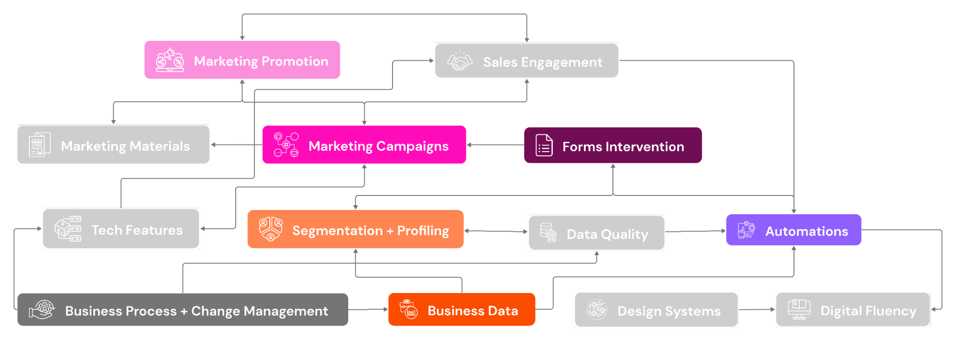
Phase Two | XX
Completion By: September 1
OVERALL IMPACT
59
Key Differences:
Initiatives set for seasonality impact
Specific epics deprioritized based on inability to complete in time Sept 1
Biz Process + Chg Mgmt
Marketing + Engagement
Data + Performance
Tools + Tech

Slide 89
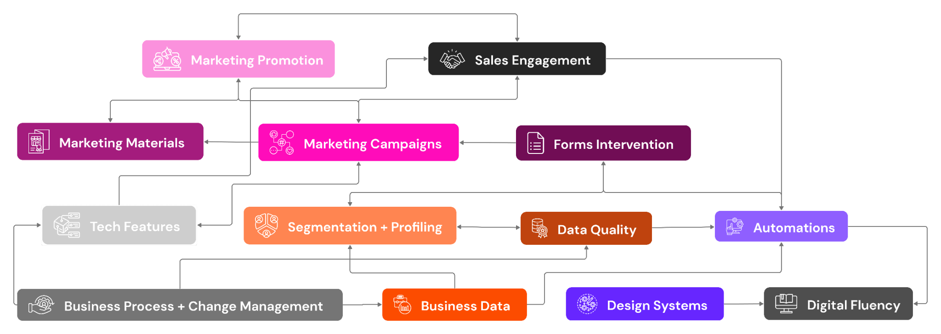
Phase Three | XX Final
Completion By: Ongoing/Not Specified
OVERALL IMPACT
93
Key Differences:
Items falling outside of season impact placed in ongoing
Tech Features removed
Certain epics removed
Biz Process + Chg Mgmt
Marketing + Engagement
Data + Performance
Tools + Tech

Slide 90
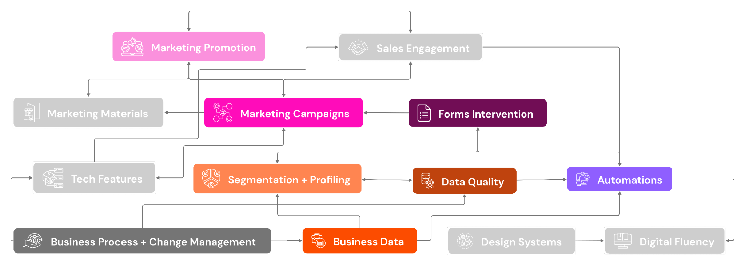
Phase One | Preferred MVP
Completion By: 3-6 months
OVERALL IMPACT
69
Key Differences:
Starting more initiatives at first
Plan for completing all epics within initiative
Utilize variable timelines depending on epic lift
Biz Process + Chg Mgmt
Marketing + Engagement
Data + Performance
Tools + Tech

Slide 91
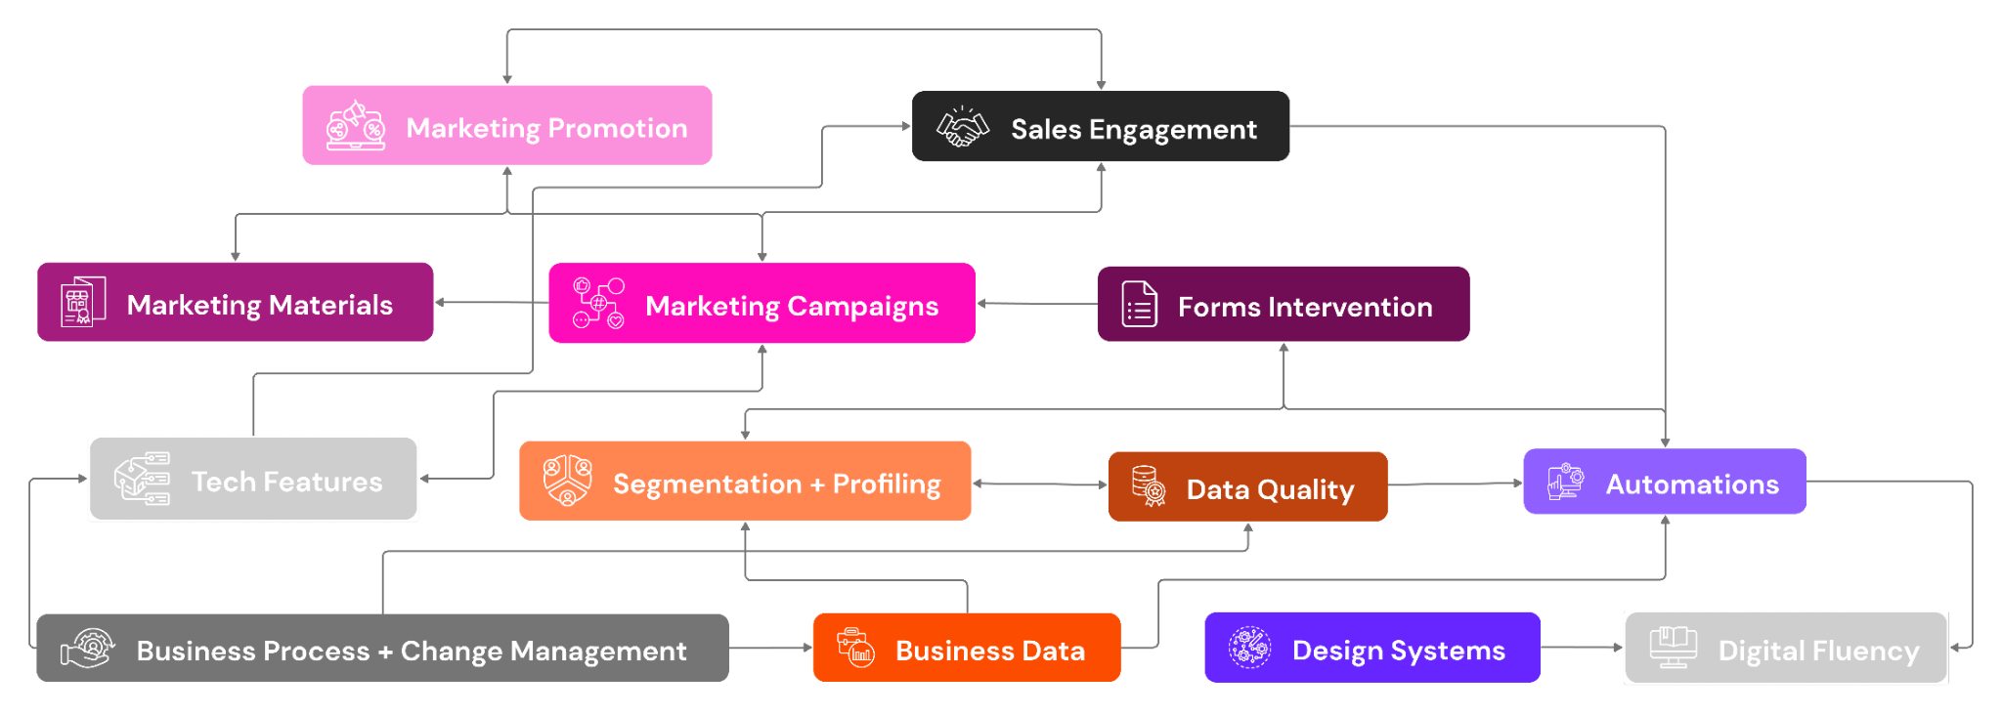
Phase Two | Expanding efforts
Completion By: 3 months
OVERALL IMPACT
76
Key Differences:
Building on initial phase
Continuing certain epics from Phase 1
Biz Process + Chg Mgmt
Marketing + Engagement
Data + Performance
Tools + Tech

Slide 92
Phase Two | Ensuring completion
Completion By: 3 -6 months
OVERALL IMPACT
100
Key Differences:
All initiatives and epics within completed to totality
Biz Process + Chg Mgmt
Marketing + Engagement
Data + Performance
Tools + Tech

